Slide 1
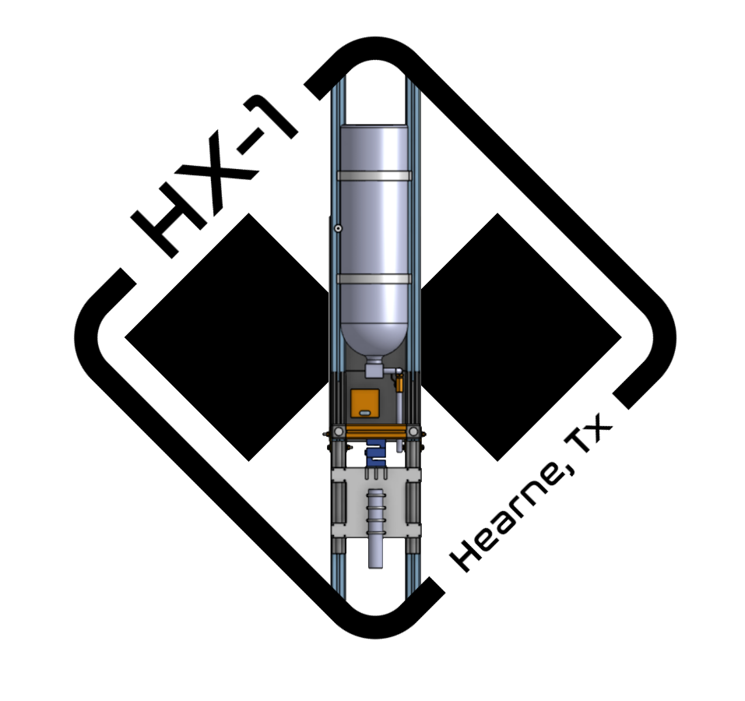
Critical Design Review:
Hybrid Experimental Engine-1 (HX-1)
Notes:
NICK/PABLO
Introduce Presentation and speakers (Leads & Roles)
Summarize HX-1 (Small scale COTS engine static fire proof of concept for 11/8 at Hearne)

Slide 2
Table of Contents
Design Requirements
Modeling
Thrust Chamber
Fluid System
Test Stand
Electronics
Project Introduction
Project Initiation
HX-1 Subsystems
Modeling
Thrust Chamber
Fluid System
Test Stand
Electronics
Future Plans (HX-2, REU, IREC)
Current Speaker: Mr. Aero Mavs
Next Speaker: Ms. Aero Mavs
Notes:
Pablo continue
Design Requirements: Pablo
Modelling: Karthik
Thrust Chamber: Karthik & Jonathan
Fluid System: Pablo & Joel
Test Stand: Jonathan & Joel
Electronics: Aly

Slide 3
AeroMavs Organizational Structure
Advisor: Dr. B. Chudoba
Advisor: Dr. H. Chen
President: Deeva Khanuja
Vice President: Allison Prause
Fixed Wing
Hybrid Rocketry
Solid Rocketry
Current Speaker: Mr. Aero Mavs
Next Speaker: Ms. Aero Mavs

Slide 4
Hybrid Division Structure
Hybrid Division
Chief Engr: Nicholas Quillin
Project Manager: Pablo Martinez
Experimentals Lead:
Karthik Nuti
Electrical Lead:
Aly Haider
Mechanical Co-lead:
Joel John
Mechanical Co-lead:
Jonathan White
Current Speaker: Mr. Aero Mavs
Next Speaker: Ms. Aero Mavs

Slide 5


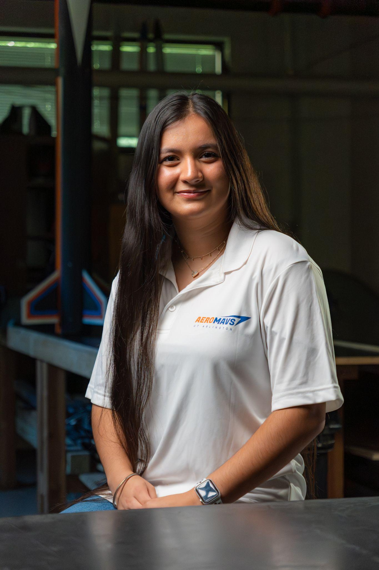
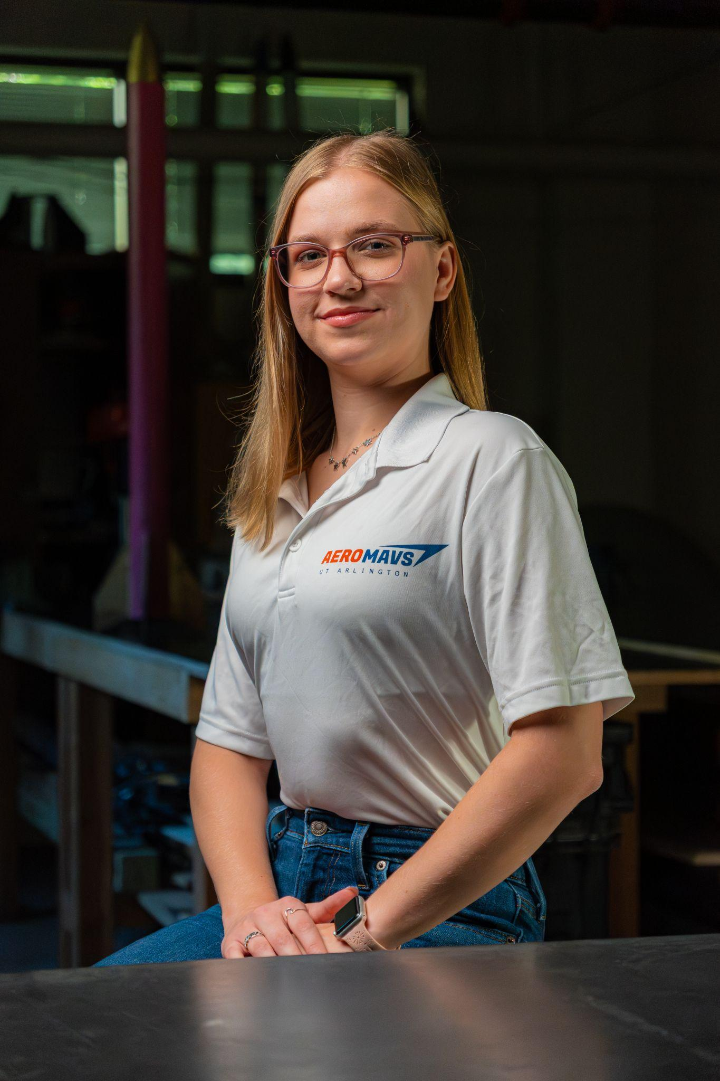
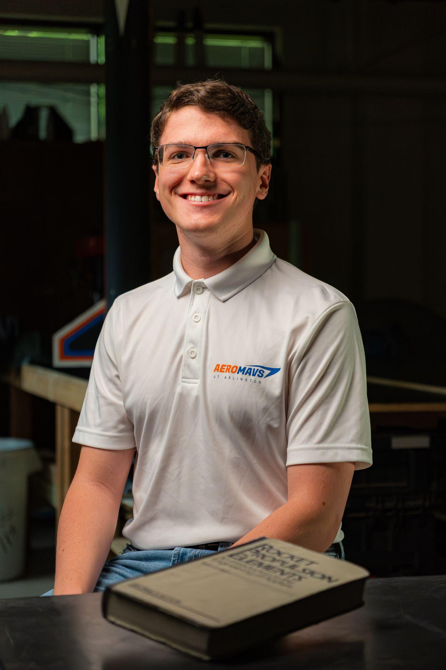
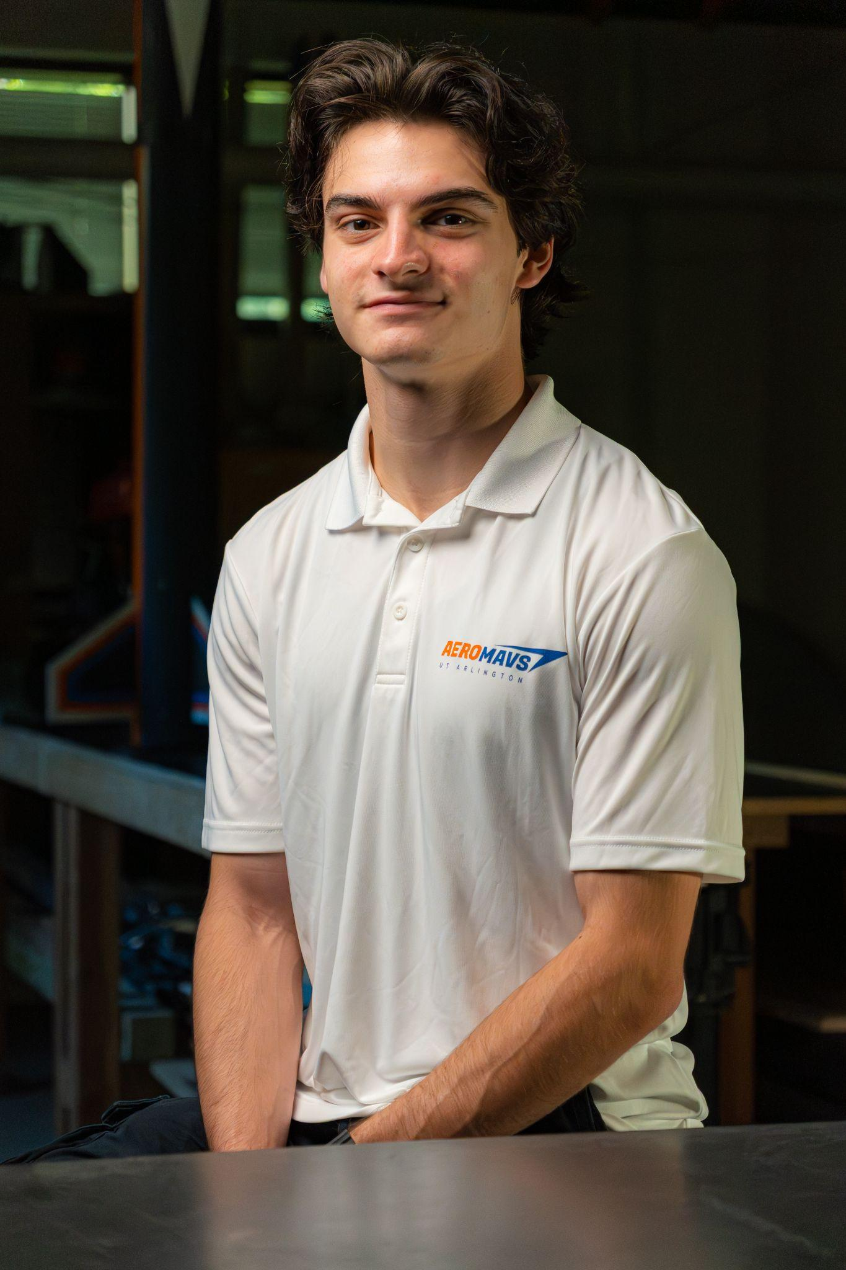
HYBRID TEAM INVOLVED
Advisors
Leadership Involved
Leads
Karthik Nuti
Aly Haider
Joel John
Jonathan White
Experimentals
Electrical
Mechanical
Mechanical
Dr. Bernd Chudoba
Dr. Hongru Chen
Deeva Khanuja
Allison Prause
Nicholas Quillin
Pablo Martinez
ADVISOR
ADVISOR
Hybrid Rocketry Chief Engineer
Hybrid Rocketry Project Manager
President
Vice President
Email: Chudoba@uta.edu
Email: Hongru.chen@uta.edu
Email: aeromavs@gmail.com
Current Speaker: Mr. Aero Mavs
Next Speaker: Ms. Aero Mavs

Slide 6




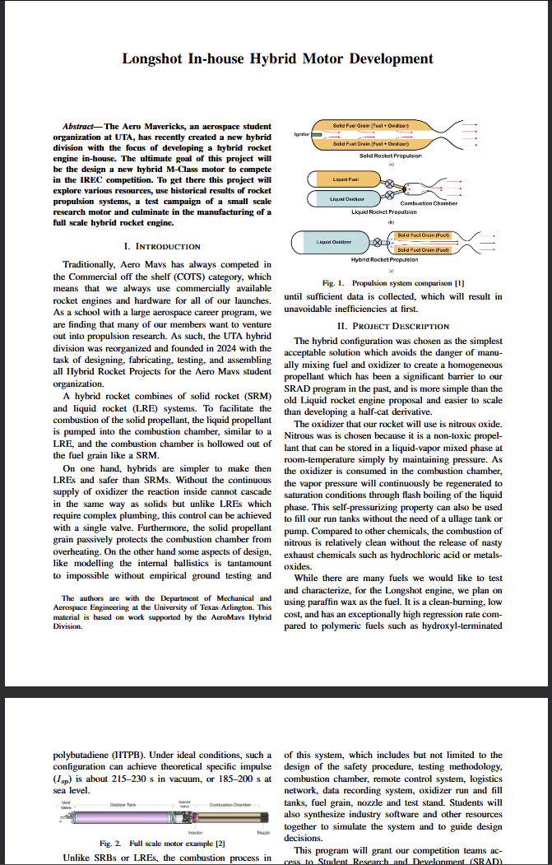
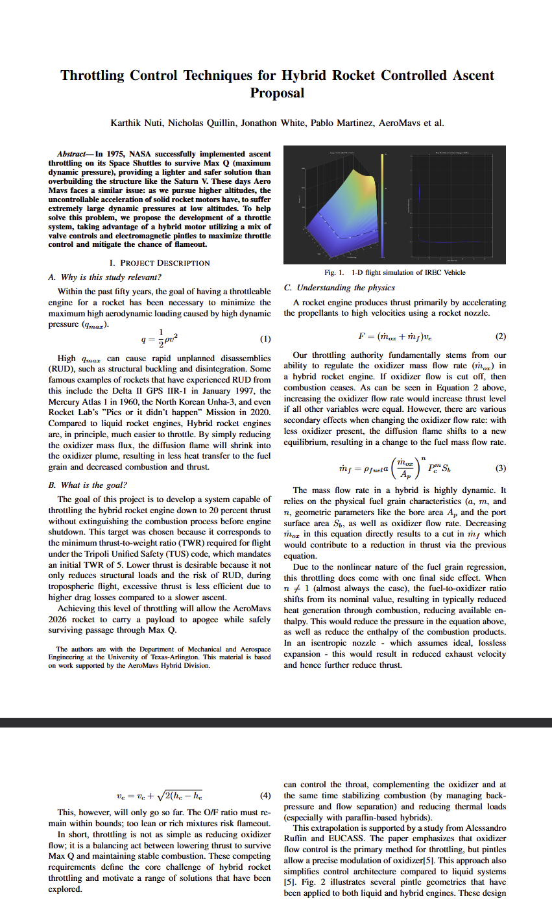
Mission Overview
11.25
12.25
1.26
2.26
3.26
4.26
5.26
Upcoming Missions
Demonstrator
- Build Experience and protocol
- Collect preliminary performance data
Technology Testbed
- 3D reinforced propellants
- Throttling
High Fidelity Engine Modelling
Test a M-Class Motor
Current Speaker: Mr. Aero Mavs
Next Speaker: Ms. Aero Mavs

Slide 7
Project Overview: HX-1
PROJECT OVERVIEW: HX-1
By: Nicholas Quillin, Pablo Martinez
Objectives:
Gain regression data.
Confirm theories of characteristics.
Achieve multi test capability.
Output:
Functional test hardware.
Data to improve upon for HX-2.
Future:
HX-2 second iteration of the experimental hybrid.
Mission Requirements:
Prove the feasibility of HX-1
Iterative design that can be scaled for HX-2
Objectives:
Do multiple short test burns
Gain regression data
Analyze and validate initial estimates
Output:
Determine parameter deviations
Identify improved parameter fidelity for HX-2
Literature Review:
[1] “Mojave Sphinx,” Half Cat Rocketry Available: https://www.halfcatrocketry.com/mojave-sphinx.
[2] Ogata, K., Modern Control Engineering, Prentice Hall, 2022.
[3] Nise, N. S., Control Systems Engineering, Hoboken, NJ: Wiley, 2015.
[4] Newlands, R. M., Science and design of the Hybrid Rocket Engine, Lulu, 2017.
[5] Humble, R. W., Henry, G. N., and Larson, W. J., Space Propulsion Analysis and design, New York: McGraw-Hill, 2007.
[6] Sutton, G. P., and Biblarz, O., Rocket Propulsion Elements, Ninth Edition, John Wiley & Sons (US), 2017.
Current Speaker: Mr. Aero Mavs
Next Speaker: Ms. Aero Mavs

Slide 8


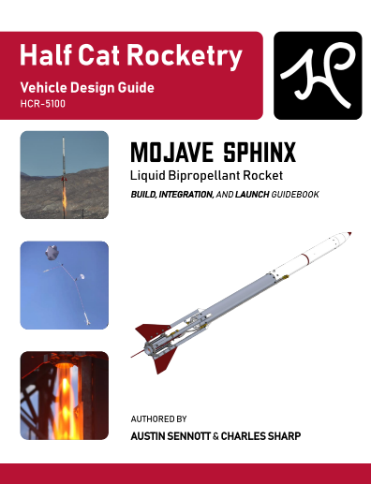

Specified Literature
Control Systems engineering
Control systems: planning pintle injector variance
Nise, N. S., Control Systems Engineering, Hoboken, NJ: Wiley, 2015.
Rocket Propulsion Elements (9th edition)
Defined the fundamentals for rocket propulsion including nozzle theory, propellant analysis, and flight performance
Helped us define parameters and understand the necessary equations for the motor.
Sutton, G. P., and Biblarz, O., Rocket Propulsion Elements, Ninth Edition, John Wiley & Sons (US), 2017.
Mojave Sphinx HCR 5100
Successfully flown low budget bipropellant liquid rocket design
Helped us source parts at affordable prices and precedent for cost cutting measures
The design of the servo-actuated ball valve
Practical safety and testing
“Mojave Sphinx,” Half Cat Rocketry Available: https://www.halfcatrocketry.com/mojave-sphinx.
Space Propulsion Analysis and Design
Chapter 7 talks about hybrid rocket propulsions.
Helped us define basic parameters of said hybrid engine. Provided basic information about internal ballistics utilizing regression rates, modelling, and burning rate equations.
Humble, R. W., Henry, G. N., and Larson, W. J., Space Propulsion Analysis and design, New York: McGraw-Hill, 2007.
Current Speaker: Mr. Aero Mavs
Next Speaker: Ms. Aero Mavs

Slide 9


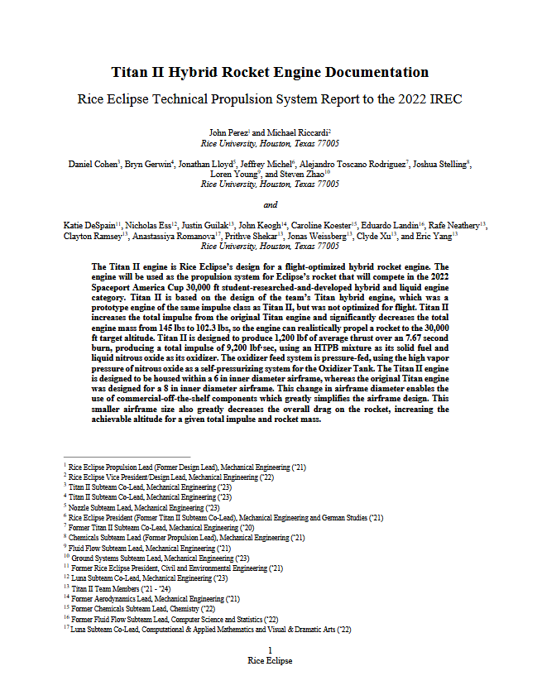
Specified Literature
Science and Design of HRE
Provides insight into the basics of rocketry.
Explains how to design and build a functional hybrid engine.
Also explains which set of propellants are suggested to use in these systems (ie. using N2O).
Newlands, R. M., Science and design of the Hybrid Rocket Engine, Lulu, 2017.
Modern Control Engineering (5th Edition)
Helped define and design the basics of the electrical systems for control surfaces. Also helped establish solutions for electrical designs for the entire engine.
Ogata, K., Modern Control Engineering, Prentice Hall, 2022.
Titan 2 Hybrid Rocket Engine Documentation
Successfully flown hybrid engines
Helped us source parts at affordable prices and precedent for cost cutting measures
The design of the servo-actuated ball valve
Practical safety and testing
“Titan Hybrid Engines,” Rice Eclipse Available: https://eclipse.rice.edu/titan-hybrid-engines.
Current Speaker: Mr. Aero Mavs
Next Speaker: Ms. Aero Mavs

Slide 10


Organizations Consulted
Rice Eclipse: Titan 2
We looked to Rice eclipse for inspiration on designing and testing hybrid engines especially considering their success with Titan 2. They also had a standard for safety, SOP, N2O, Phenolic liner, Test stand
Website:https://eclipse.rice.edu/titan-hybrid-engines
Half-Cat: Mojave Sphinx
We looked to Half-cat to inspiration on the utilization of N2O as an oxidizer and the design specifications to move the fluid. We also looked to their combustion chamber for reference.
Website:https://www.halfcatrocketry.com/mojave-sphinx
Current Speaker: Mr. Aero Mavs
Next Speaker: Ms. Aero Mavs

Slide 11
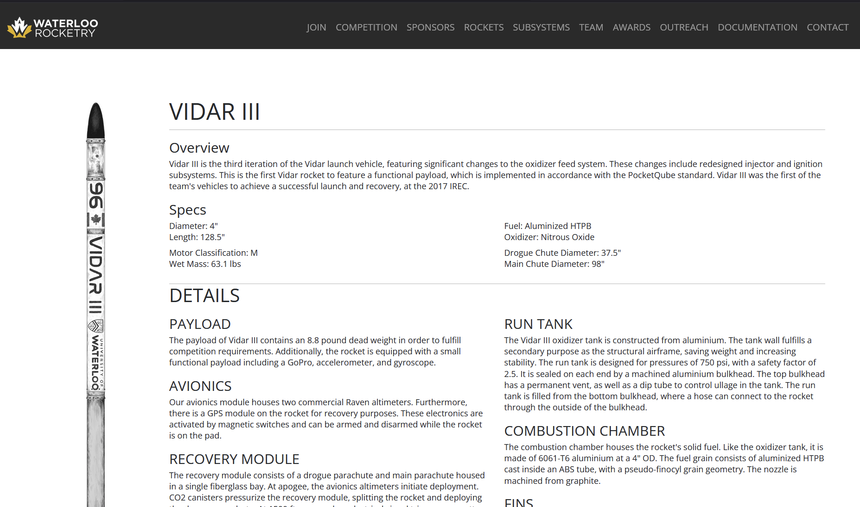
Organizations Consulted
University of Waterloo: Vidar III
We looked to Waterloo Rocketry for inspiration on designing and testing hybrid engines especially considering their success with Vidar III 2017 IREC Rocket: we got ideas on safety, SOPs, and using nitrous oxide.
Website:https://www.waterloorocketry.com/rockets/vidar3
Current Speaker: Mr. Aero Mavs
Next Speaker: Ms. Aero Mavs

Slide 12
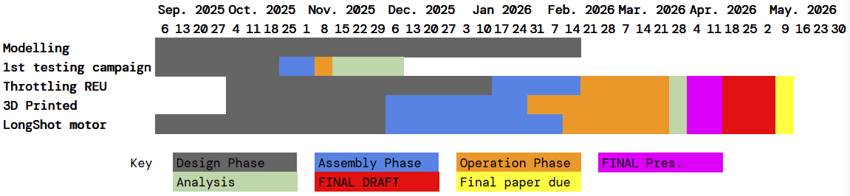
TIMELINE: HX-1
Current Speaker: Mr. Aero Mavs
Next Speaker: Ms. Aero Mavs

Slide 13
Summary -

Slide 14
Design Requirements
Design Requirements help organize and direct the project.
These design requirements inform every aspect of design and will be referenced throughout.
Current Speaker: Mr. Aero Mavs
Next Speaker: Ms. Aero Mavs

Slide 15
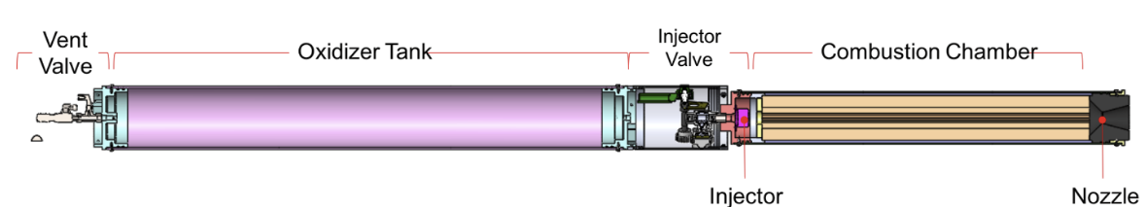
Inspiration on Engine Design
Our hybrid rocket engine has received some inspiration from Waterloo Rocketry Vidar III in terms of nitrous utilization and general designs of hybrid engines.
Waterloo Rocketry: Hybrid rocket engine IDEAs Design Analysis Competition 2018
Waterloo Rocketry, 2018
N. Christopher, S. Dalgliesh, N. Wong
Wong, N., Dalgliesh, S., Christopher, N., Lambert, S., and Hickey, J.-P., “Hybrid Rocket Engine IDEAs Design Analysis Competition 2018,” Waterloo IDEAs Design Analysis Competition 2018. Available at: https://uwaterloo.ca/engineering-ideas-clinic/sites/default/files/uploads/documents/hybrid_rocket_engine_-_design_analysis_competition_presentation_1.pdf
Current Speaker: Mr. Aero Mavs
Next Speaker: Ms. Aero Mavs

Slide 16
Inspiration on Rocket Design
Once the engine has been finalized, the engine would be applied to a rocket - for now called Longshot - for an IREC competition. The diagram above is representative of how HX-1 would be applied to a competition rocket.
Waterloo Rocketry: Hybrid rocket engine IDEAs Design Analysis Competition 2018
Waterloo Rocketry, 2018
N. Christopher, S. Dalgliesh, N. Wong
Wong, N., Dalgliesh, S., Christopher, N., Lambert, S., and Hickey, J.-P., “Hybrid Rocket Engine IDEAs Design Analysis Competition 2018,” Waterloo IDEAs Design Analysis Competition 2018. Available at: https://uwaterloo.ca/engineering-ideas-clinic/sites/default/files/uploads/documents/hybrid_rocket_engine_-_design_analysis_competition_presentation_1.pdf
Current Speaker: Mr. Aero Mavs
Next Speaker: Ms. Aero Mavs

Slide 17
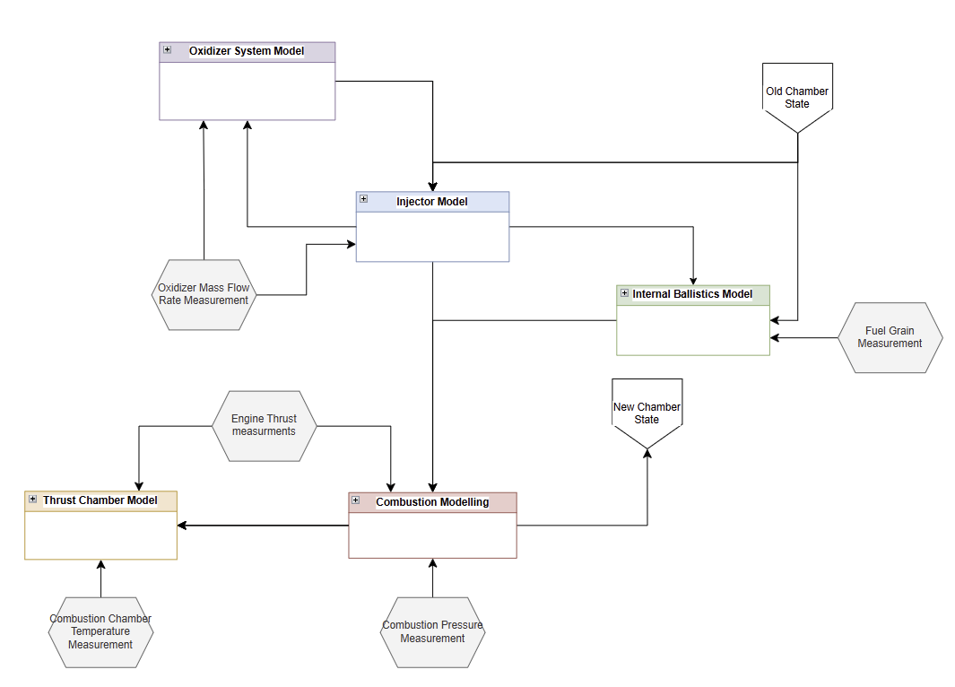
1.1 Combustion chamber
These measurements will help us tune our in-house model that will used in subsequent hybrid designs
1.1 The engine shall provide data can be used to scale the design
1.1a The engine’s thrust shall be measured
1.1b The engines pressure shall be measured
1.1c The oxidizer mass flow rate shall be measured
1.1d The fuel grain burn shall be measured
1.1e The engine temperature should be measured
Model made on DrawIO
Made by: Nicholas Quillin
Date: 10/18/25
Current Speaker: Mr. Aero Mavs
Next Speaker: Ms. Aero Mavs

Slide 18
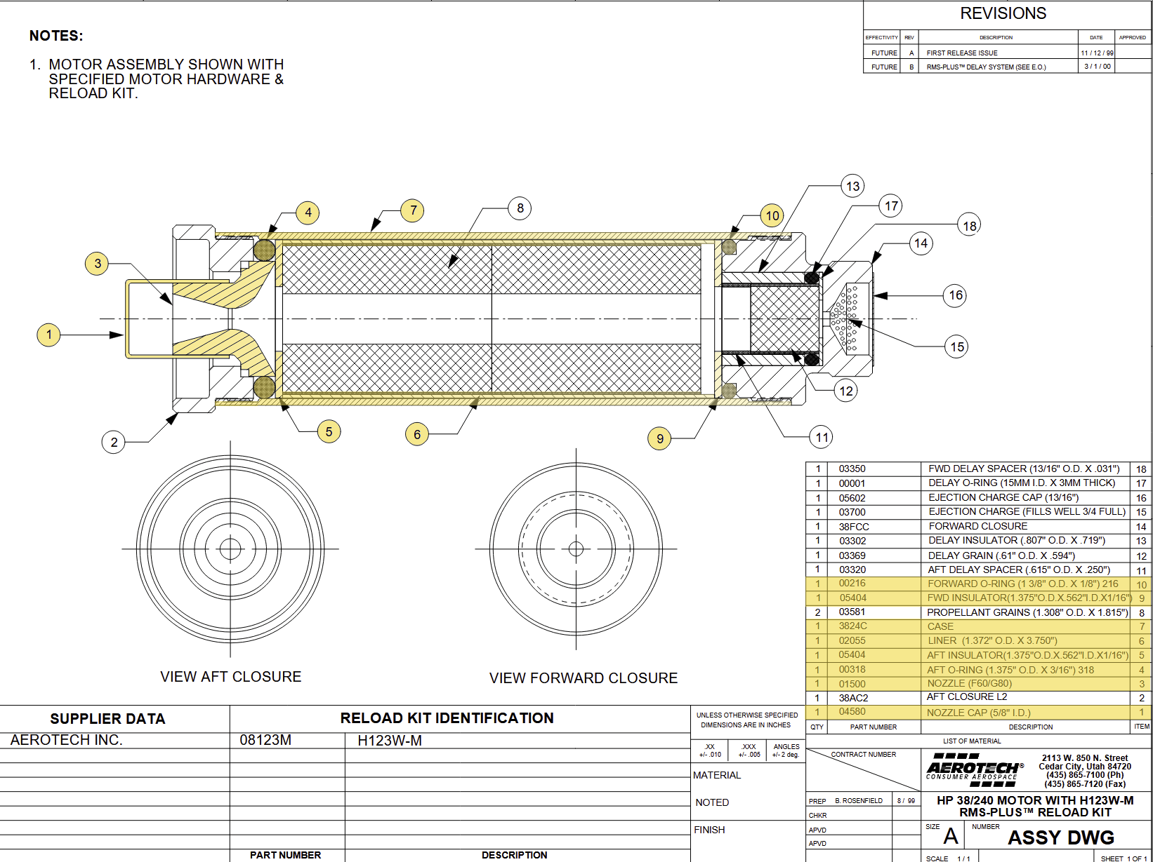
1.2 Combustion chamber
1.2 Motor should use COTS hardware wherever possible
Intended to reduce cost many of these parts are well designed, tested, and more affordable to buy.
A list of intended manufacturers are: Mcmaster carr
Many different manufacturers of COTS equipment exists
Current Speaker: Mr. Aero Mavs
Next Speaker: Ms. Aero Mavs

Slide 19
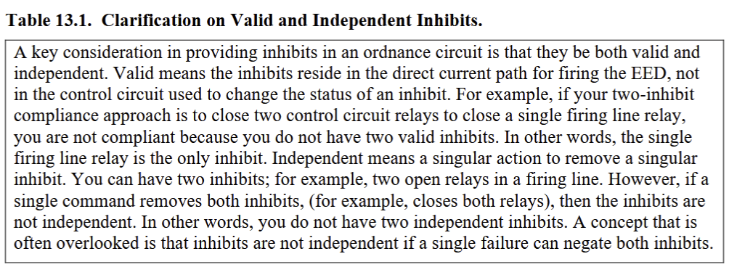
1.3 Combustion chamber
1.3 The engine shall have at least 2 inhibitions
Based on common industry practice
Current Speaker: Mr. Aero Mavs
Next Speaker: Ms. Aero Mavs
* From sscman91-710v3

Slide 20
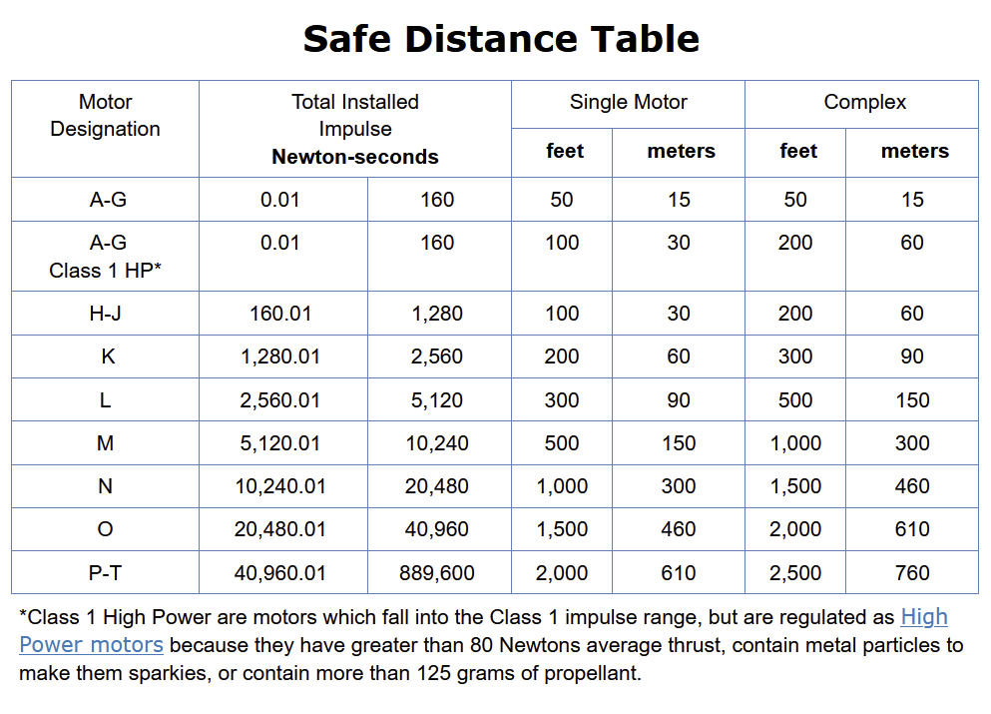
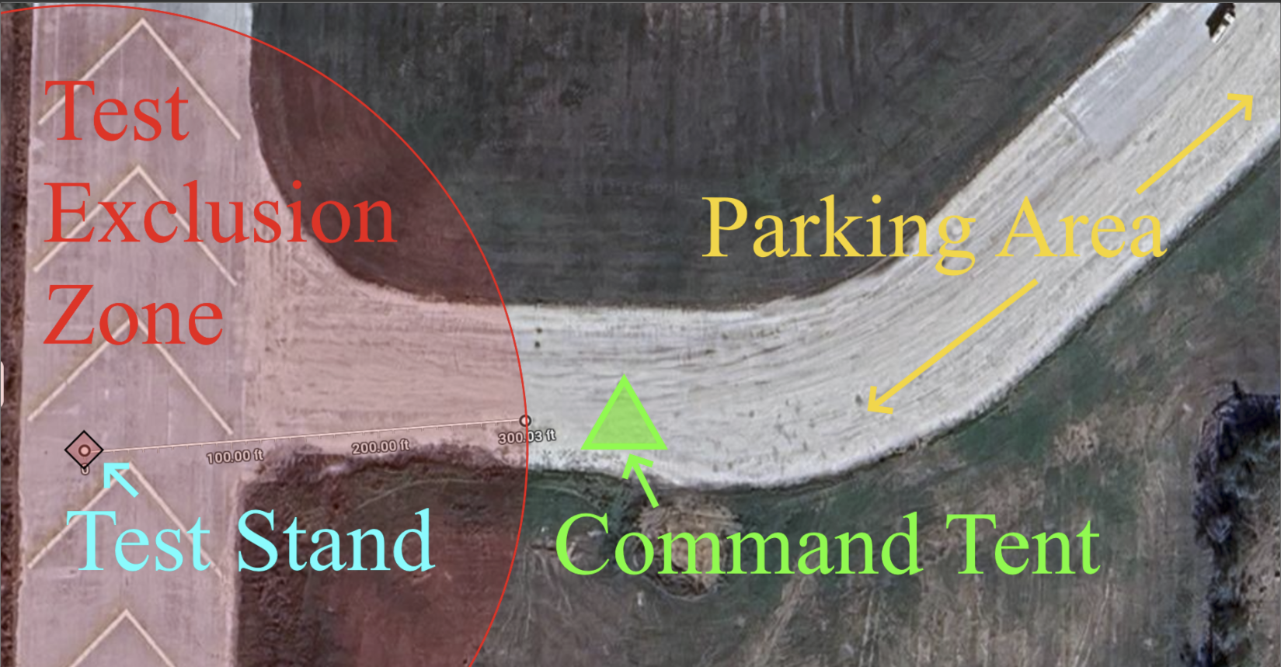
1.4 Combustion chamber
1.4 The engine shall not exceed 2000 Ns of total impulse
This requirement ensures that testing operations need not disturb regular launch operations on launch days.
Credit: Google maps
* From TRA Unified Safety Code
Current Speaker: Mr. Aero Mavs
Next Speaker: Ms. Aero Mavs

Slide 21
1.5 Combustion chamber
1.5 The engine shall conform to all of the Tripoli Rocketry Association Unified Safety Code (TRA) and National Fire Prevention Association 1125 (NFPA 1125) code.
Cite:
[1]“Tripoli Rocketry Association Safety Code ,” unified safety code - Tripoli Rocketry Association Available: https://www.tripoli.org/safetycode.
[2]“Code for the manufacture of model rocket and high power rocket motors,“ National Fire Prevention Association Available at: http://ftp.demec.ufpr.br/foguete/bibliografia/NFPA1125.pdf
Outline some of the major implications.
On most overlap TRA is typically more stringent and thus takes priority
Current Speaker: Mr. Aero Mavs
Next Speaker: Ms. Aero Mavs

Slide 22
1.6 Combustion Chamber
1.6 The Oxidizer Mass Flux shall never exceed 600 kg/m^2.
Cite:
Current Speaker: Mr. Aero Mavs
Next Speaker: Ms. Aero Mavs

Slide 23
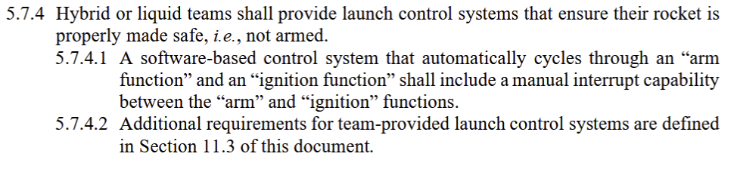
2.1 Ground System Equipment
2.1 The test stand shall be safely returned to a safe state if power is cut.
This is standard procedure and required by IREC Design Test and Evaluation guide Section 5.
“International Rocket Engineering Competition Design, Test, & Evaluation guide,“ IREC, 2025 Available at: https://www.soundingrocket.org/uploads/9/0/6/4/9064598/2025-irec_dteg_v1.1.6_02-14-25.pdf
Current Speaker: Mr. Aero Mavs
Next Speaker: Ms. Aero Mavs

Slide 24
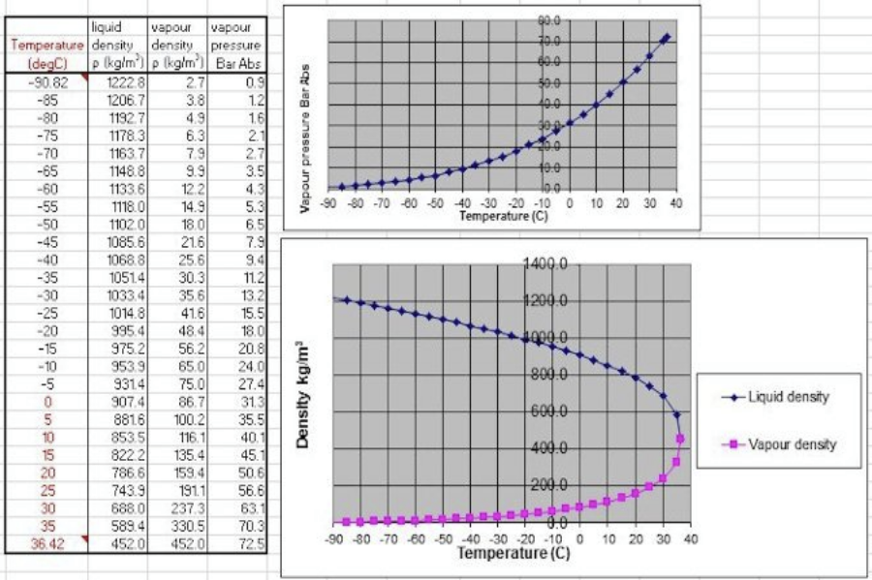
2.2 Ground System Equipment
2.2 All Nitrous systems operating downstream of main bottle valve are expected to operate at 15C or less.
Under saturated conditions, Nitrous properties scale with temperature
These properties are used to autogenously pressurize the system
Nitrous must be kept below this temperature in order to not exceed design requirements
Nitrous Properties from The Science and design of the Hybrid Rocket Engine, actual design uses tabulated properties from coolprop
Newlands, R. M., Science and design of the Hybrid Rocket Engine, Lulu, 2017.

Slide 25
2.3 Ground System Equipment
2.3 All pressurized systems must be designed with a minimum FOS of 2 and tested to 1.5 times the Maximum expected operating pressure (MEOP). 2.3a All parts including the combustion chamber MEOP is to be considered at Maximum expected operating temperature (MEOT)
For commercial rockets the FOS typically ranges from 1.2-1.5. For experimental rockets FOS 2 is standard and recommended by Richard Nakka, Newlands, and ESRA
Hydrostatic testing requirements outlined by ESRA from IREC Design Test and Evaluation guide Section 6.17.6.
Current Speaker: Mr. Aero Mavs
Next Speaker: Ms. Aero Mavs

Slide 26
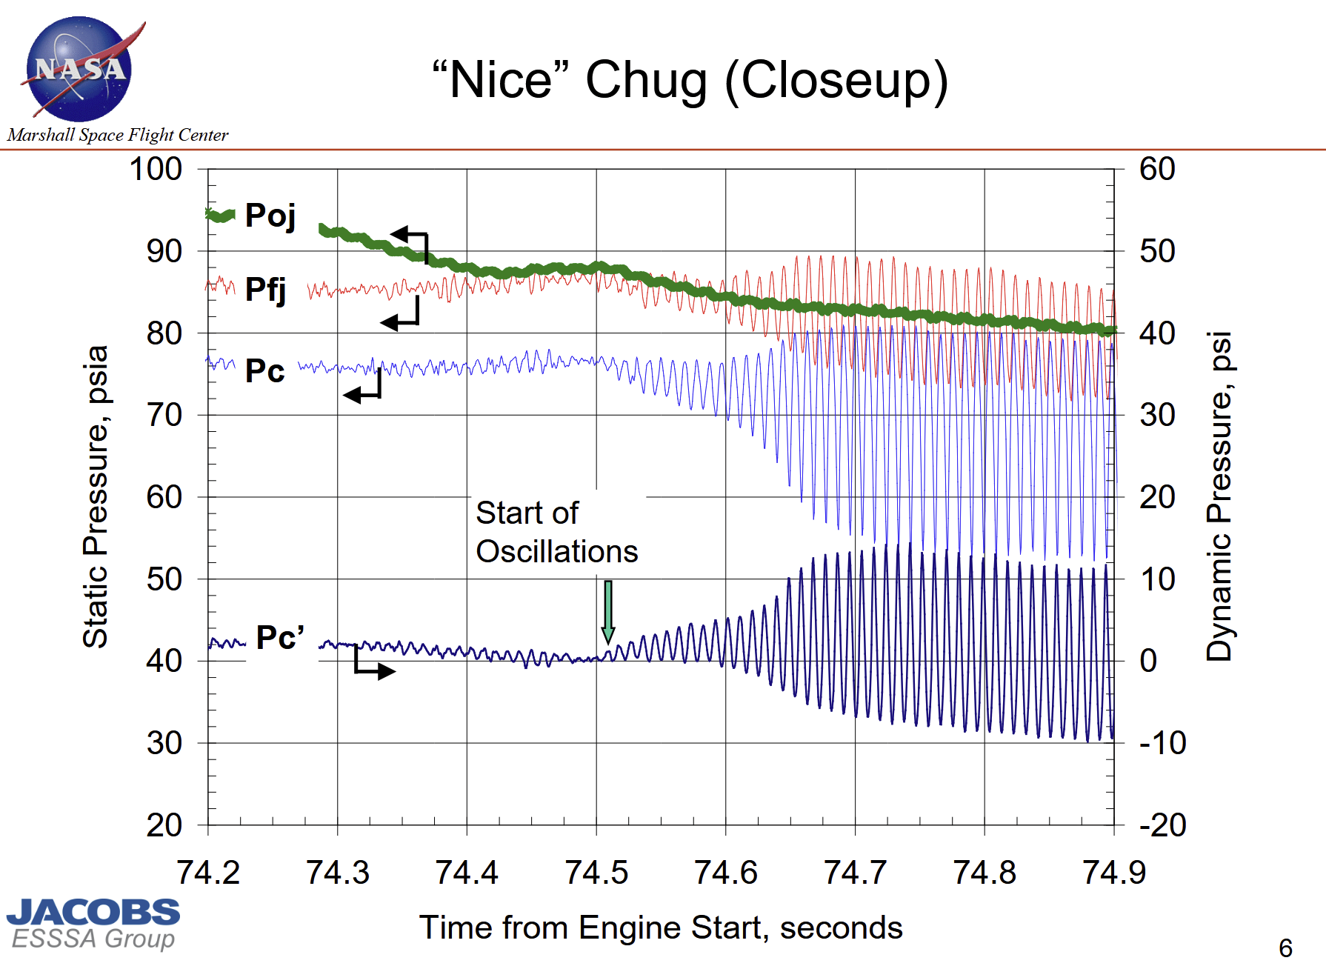
2.4 Ground System Equipment
2.4 The steady state pressure drop across the injector shall always exceed 20% of tank pressure
This is intended to harden the system against combustion instability, particularly chug instability.
A safe target recommended in The Science and Design of the Hybrid Rocket Engine by Richard Newlands
Figure is somewhat exaggerated but comes from NTRS 20170008957
[1]“Chug and Buzz.... the neglected and disrespected combustion instabilities - NASA technical reports server (NTRS),” NASA Available: https://ntrs.nasa.gov/citations/20170008957.
[2] “Science and design of the Hybrid Rocket Engine,”Newlands, R. M. 2017.

Slide 27
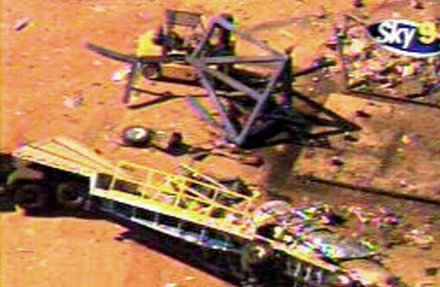
2.5 Ground System Equipment
2.4 The test stand shall always be grounded
This requirement is to avoid accidental sparking resulting in Nitrous oxide decomposition.
Scaled Composites Cold-flow failure caused by Nitrous oxide decomposition
Picture credit:

Slide 28
3.1 Manufacturing
Machining will be done primarily through UTA machine shop.
Only metal parts should be machined.
This requirement is in order to avoid the safety implications of machining and manufacturing phenolic, graphite, and other materials.
Current Speaker: Mr. Aero Mavs
Next Speaker: Ms. Aero Mavs

Slide 29
3.2 Manufacturing
3.2 The oxidizer system shall be cleaned of all combustible matter
This is required to avoid the spontaneous combustion in an oxygenated environment

Slide 30
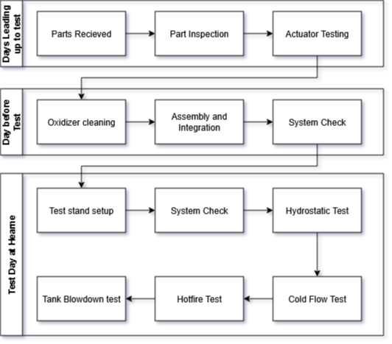
Testing Summary
Parts Received -
Diagram made by: Nicholas Quillin
Date:
Software:
Sources:
Current Speaker: Mr. Aero Mavs
Next Speaker: Ms. Aero Mavs
Notes:
Suddartian
ANd the design

Slide 31
Budget
Budget: HX-1
Total Budget: $1543.19
HX-1 Projected Expenditures: $794.33
Majority of Test Stand components are sourced from the lab
Nitrous Oxide Equipment | $41.40
Thrust Chamber | $16.51
Nitrogen Purge System | $263.40
Test Stand | $42.03
Electronic Components | $321.24
Hydrostatic Test | $70.98
Cleaning Equipment | $24.68
Current Speaker: Mr. Aero Mavs
Next Speaker: Ms. Aero Mavs
Notes:
Expenses in Electronics are mostly due to the expense of sensors. The pressure transducers in particular is extremely expensive.

Slide 32
Summary -

Slide 33
HX Simulation Models
The purpose of HX-1 as well as all the subsequent systems in the HX series is to collect data for an in-house design tool which will pave the way for future designs
This section goes over this product piece of SOFTWARE that will be produced using HX Data
HX Model is incomplete without test data, so the design of HX-1 makes heavy use of external resources and data to get an approximate
Notes:
KARTHIK / NICK

Slide 34
Simulation Model Architecture
HX-1 is composed of various simulations, primarily written in the MATLAB/Simulink/Simscape environment.
While the model uses both empirical and theoretical relations to model the system.
This section will predominantly go over some of the models used as well as their limitations and state of development
Diagram made by: Nicholas Quillin
Date: 10/18/25
Software: DrawIO
Sources:
Current Speaker: Mr. Aero Mavs
Next Speaker: Ms. Aero Mavs

Slide 35
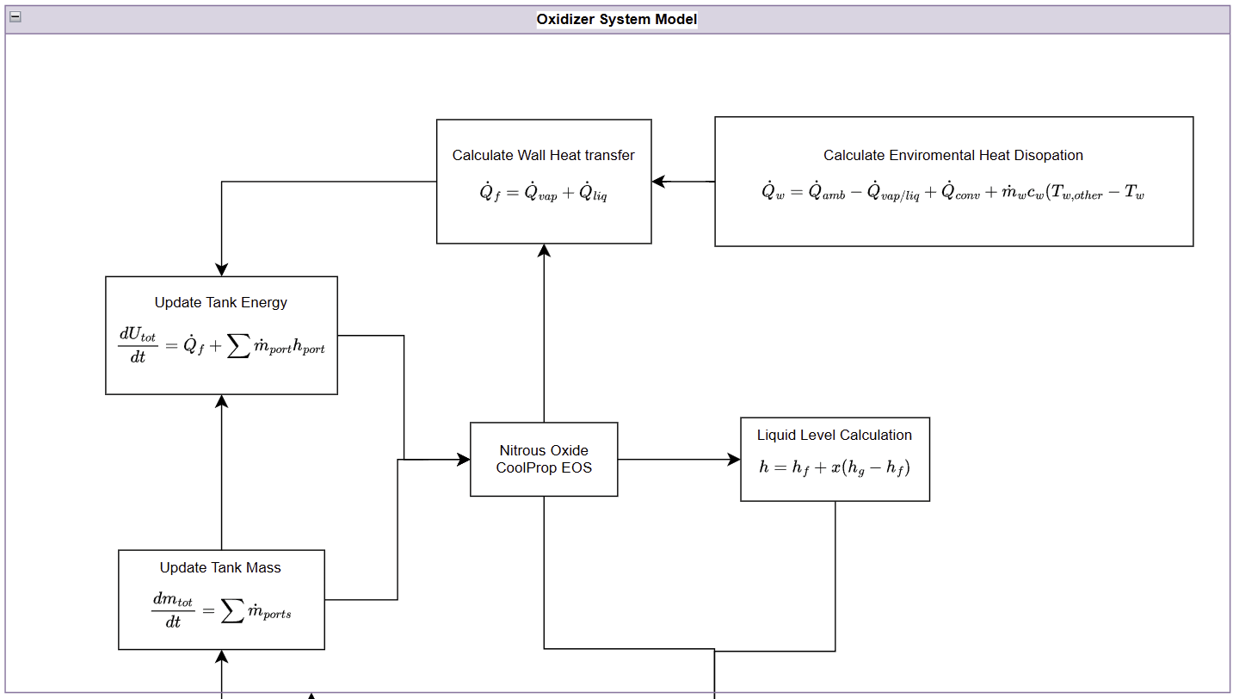
Tank Simulation diagram (Matlab/Simulink)
Currently assumes
Check Documentation for usage
Thermochemical Data from Precompiled LUT in CoolProp
Secondary simscape model
Equilibrium tank simulation based on on this research
Current Speaker: Mr. Aero Mavs
Next Speaker: Ms. Aero Mavs
Notes:
Explain parameters -describing hardware
Should convey Add all necessary info for someone who is not present. It should convey information to people it is sent too

Slide 36
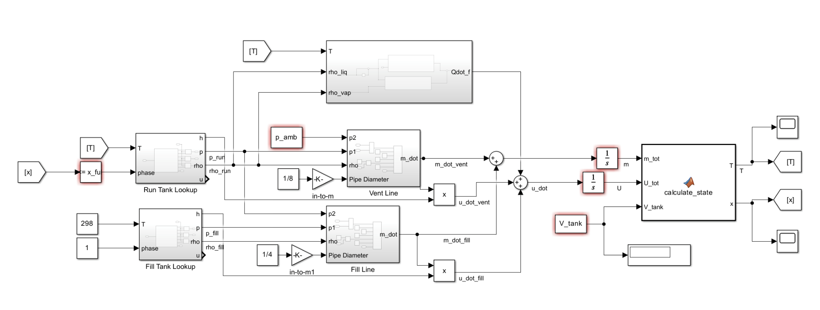
Tank Simulation (Matlab/Simulink)
2 models in use
written in simulink model shown below, this one is more versatile and will be expanded upon later to take in account dynamic-non equilibrium behavior.
Written in simscape, mainly used for validation at the moment but will be combined with the first at some point using custom simscape components
Current implementation in simscape
By: Nicholas Quillin
Date:
Current Speaker: Mr. Aero Mavs
Next Speaker: Ms. Aero Mavs
Notes:
Explain parameters -describing hardware
Should convey Add all necessary info for someone who is not present. It should convey information to people it is sent too

Slide 37
Flow simulation and calculation
The main constriction in
The Model utilizes the following equation:
The Model assumes the following:
Current Speaker: Mr. Aero Mavs
Next Speaker: Ms. Aero Mavs

Slide 38
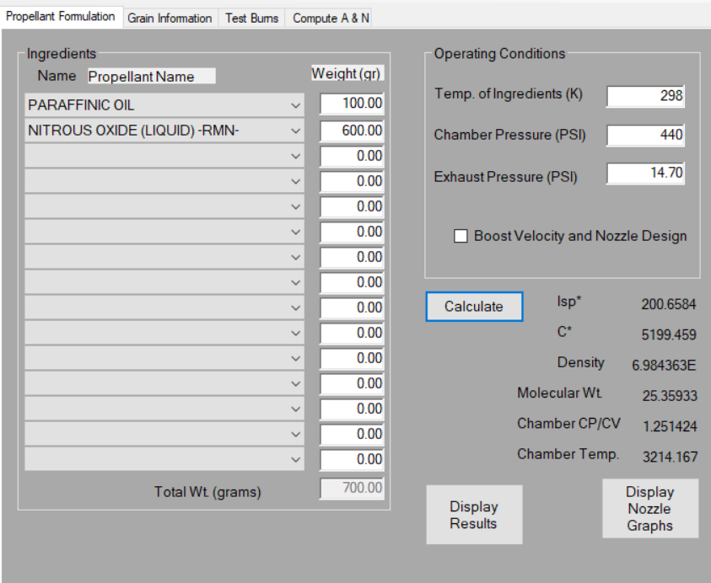
Chemical Equilibrium
ProPEP
NASA CEA
Determine the heat generated for any system
Model is made through Simscape 2025A
By: Pablo Martinez
Date:
Current Speaker: Mr. Aero Mavs
Next Speaker: Ms. Aero Mavs
Sources
Notes:
Ran proppep analysis of wax and N2O using specific weights and related pressures. Run the program
Still working out inconsistencies with CEA analysis (parrafin requires custom configuration which the data will be used to improve) Multiple modes of CE and
Software age and source
How it was validated
WHAT SOFTWARE AGE AND SOURCE

Slide 39
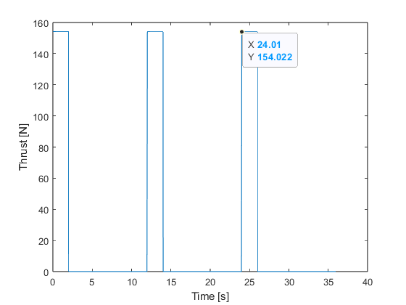
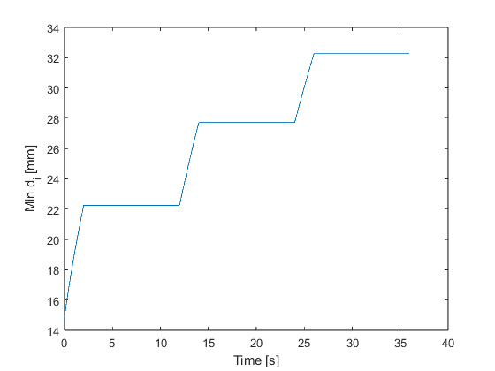
Internal Ballistics
Internal ballistics is the study of how propellant burns and behaves inside the combustion chamber. Thus the effect is how that internal behavior sets chamber pressure, mass flow, and ultimately thrust.
The initial simulation models are homogenous types - it is a simplified theoretical model and assumes that all gasses in the chamber are perfectly mixed. It will be able to model dynamic burning.
The matlab provided graphs provided are too idealistic; however, they provide a clear insight on the pulsing hot-fire test. The top graph focuses on the the thrust produced from the pulse.
Model made through Matlab 2024B
By: Karthik Nuti
Date:
Current Speaker: Mr. Aero Mavs
Next Speaker: Ms. Aero Mavs
Notes:
Need data to form a proper model.
Initial model used a homogenous model. Our model will be able to model dynamic burning.
Add the definition of internal ballistics
Significant digits
MATLAB

Slide 40
Internal Ballistics
Internal Ballistics Code Analysis
By: Karthik Nuti
Date: 10.19.25
Code Requirements:
Provide a rudimentary analysis on the combustion of fuel grain
Inputs/Parameters:
Total Impulse: It = 1000. [Ns]
Specific Impulse: Is = 200.0 [s]
Gravitational acceleration at Hearne: g = 9.820 m/s^2
Oxidizer-to-Fuel Ratio: O/F = 6.000
Fuel density: ρ = 870.0 [kg/m³]
Regression coefficient: a = 0.1146
Regression exponent: n = 0.5036
Oxidizer mass flux: G = 128.0 [kg/m²·s]
Fuel grain length: L = 0.1199 [m]
Outer diameter (design): D = 0.03332 [m]
cstar=1500;
Nozzle throat area=7.126e-5 [m^2]
Gas-side h during burn = 8000.
Gas temp during burn (CEA) =2800.;
N2 cooling (depends on purge flow)=300.0 [W/m^2-K]
Purge gas N2 temperature = 300.0 [K]
Paraffin wax cp=2200. [J/kg-k]
Delta (effective heated layer) = 7.500e-4 [m]
Tsurf=300.0*ones(N,1);
Burn_dt (burn phase timestep) = 0.0050 [s]
Purge_dt (purge timestep) = 0.0500 [s]
Burn_time (duration per pulse) =2.000 [s]
Purge_time (purge duration per gap) = 10.00 [s]
Pulses (number of pulses) = 3.000
relax (under-relaxation factor) =0.6000
Initialize Parameters
Burn Phase (2 second pulse):
Iterate for burn time (ensuring burn time is within 2 seconds).
Within this loop
Geometry Update:
Purge Phase:
Utilizing the purge flow in
Plot data against time:
Plot 1: Thrust vs Time
Port Diameter vs Time
Output:
Thrust vs Time
Port Diameter vs Time
Current Speaker: Mr. Aero Mavs
Next Speaker: Ms. Aero Mavs

Slide 41
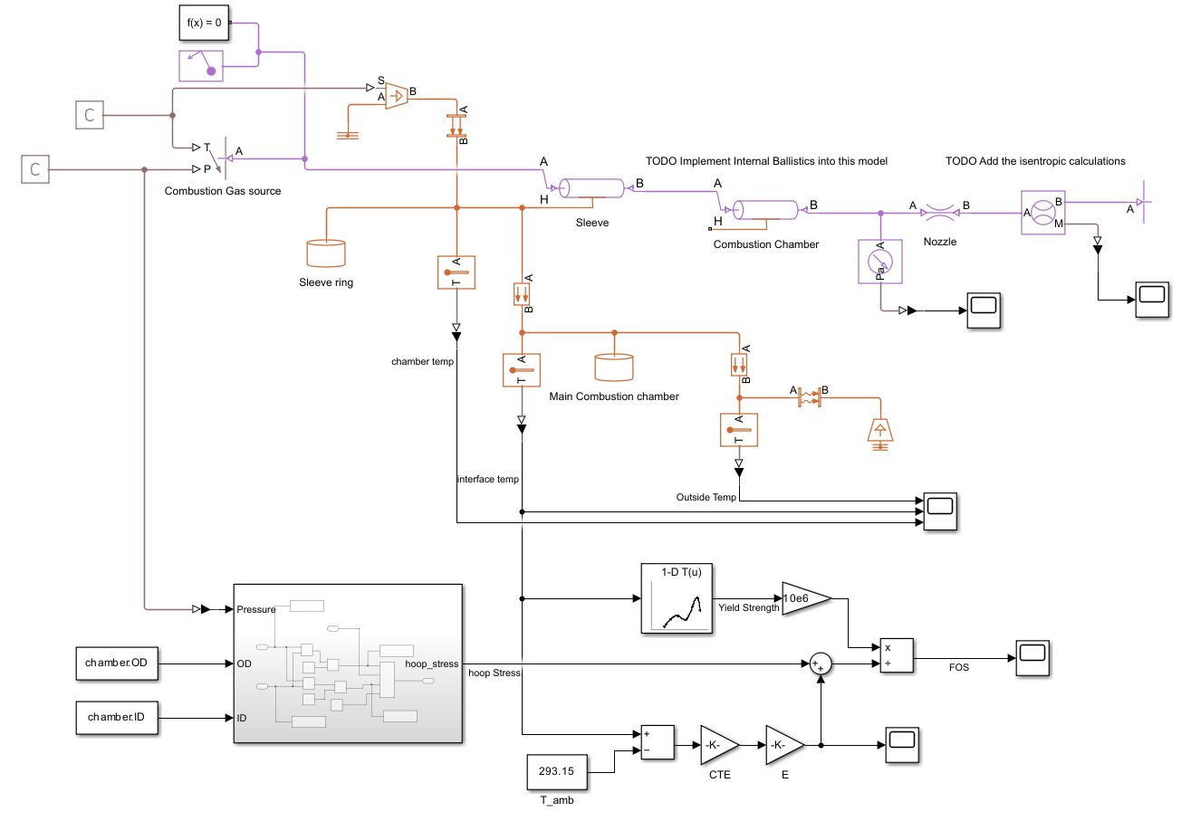
Thrust simulation (simscape)
Simulink Model
Heating of pipe
Stress and strain of combustion chamber.
Manual Calculations
Injector
Nozzle Flow
CFD simulations
Axisymmetric Flow simulation
Model is made through Simscape 2025A
By: Nicholas Quillin
Date:
Current Speaker: Mr. Aero Mavs
Next Speaker: Ms. Aero Mavs
Notes:
Using simscape to model the heat transfer and the subsonic flows. FINISH!!!!!!!!!!!!
Where is the source code
Work in Progress
Uncertainties

Slide 42
Data Analysis
Extracting data on regression rate, O/F ratio, Thrust curve, and Chamber pressure & blowdown profile
Organization of data within a burn log in a database
Test ID, grain geometry, tank fill, ignition method, run time, etc.
Pre/post tank mass (oxidizer used)
Pre/post grain mass or port measurements
Pressure trace file, thrust data
Version Control of Raw versus Processed Data
DAQ vs analysis sheet
Process each data set
Fit models
Fit the regression data to the empirical law
Extract coefficients a,n with regression (curve fitting)
Compare experimental impulse and thrust to prediction from this CDR review
Compare & Conclude
Validation: Does measured thrust/impulse align with CDR estimates? Within what percent error?
Sensitivity: Which parameter caused the biggest deviation?
Next step: Identification of what HX-2 should testwith better fidelity
Graphs
Current Speaker: Mr. Aero Mavs
Next Speaker: Ms. Aero Mavs
Notes:
Karthik
Regression mainly and validation our hypothesis

Slide 43
Summary -

Slide 44
Thrust Chamber
The thrust chamber encompasses the design of the generation, containment, and expulsion of propulsive gasses.
Current Speaker: Mr. Aero Mavs
Next Speaker: Ms. Aero Mavs

Slide 45
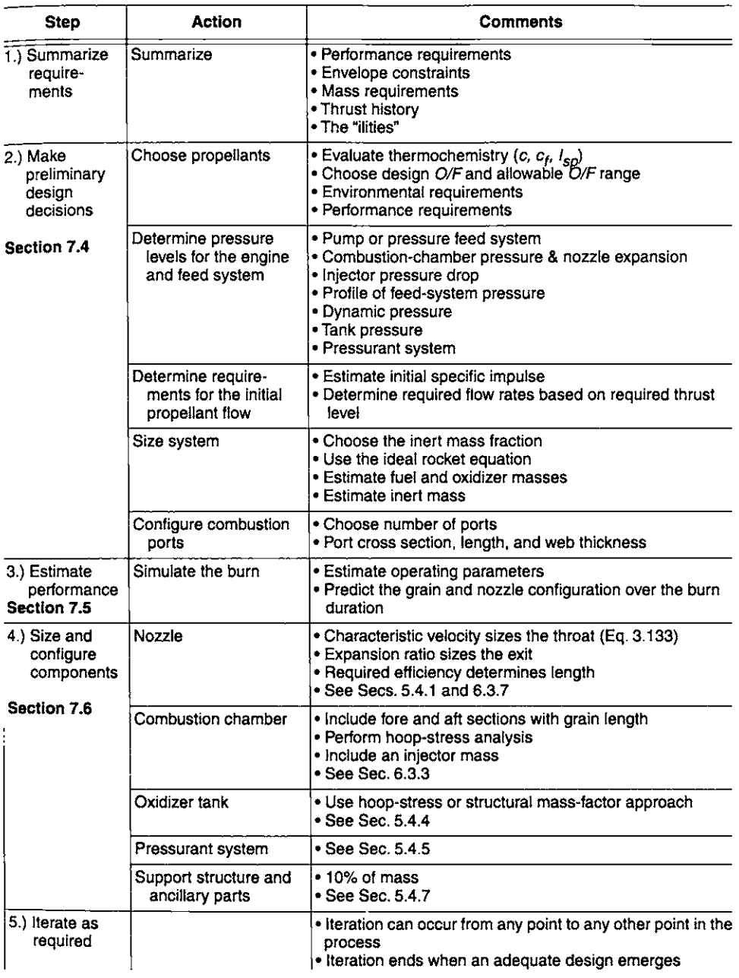
Design Procedure
Design Parameters (Preliminary design Decisions)
Simulate the burn (Done with internal ballistics model)
Size the Individual Components
* Design Procedure from Hybrid Rocket Propulsion Systems Chapter written by Ronald Humble

Slide 46
Fuel Selection
Specific Impulse: Measure of the efficiency of the propellant, data is average from Newlands. All shown propellants are similar to performance
Oxidizer to fuel ratio by wt: Larger values mean larger relative oxidizer tank weight resulting in enhanced rocket stability. data is average from Newlands, CEA, and various IREC reports,
Ease of Manufacture: Classified by process and considers the relevant safety hazards associated. Subjective Index based on past experience.
Affordability: Cost of the propellant. Compounded via amazon and RCS.
Other unlisted factors that was considered: regression rate, Transportability, Sensitivity.
Other unlisted propellants that was considered: PMMA(Acrylic), PETG, LDPE, PLA
Fuel | Specific Impulse | Oxidizer to fuel Ratio | Ease of Manufacture | Affordability
HTPB | 236 | 5.5 | Medium Chemical Casting | Average $15/kg
ABS | 232 | 5.7 | Trivial 3d Printing | Expensive ~$30/kg
Paraffin Wax | 244 | 6.0 | Easy Thermal Casting | Cheap ~$8/kg
HDPE | 235 | 6.2 | High Machining Required | Average ~$15/kg

Slide 47
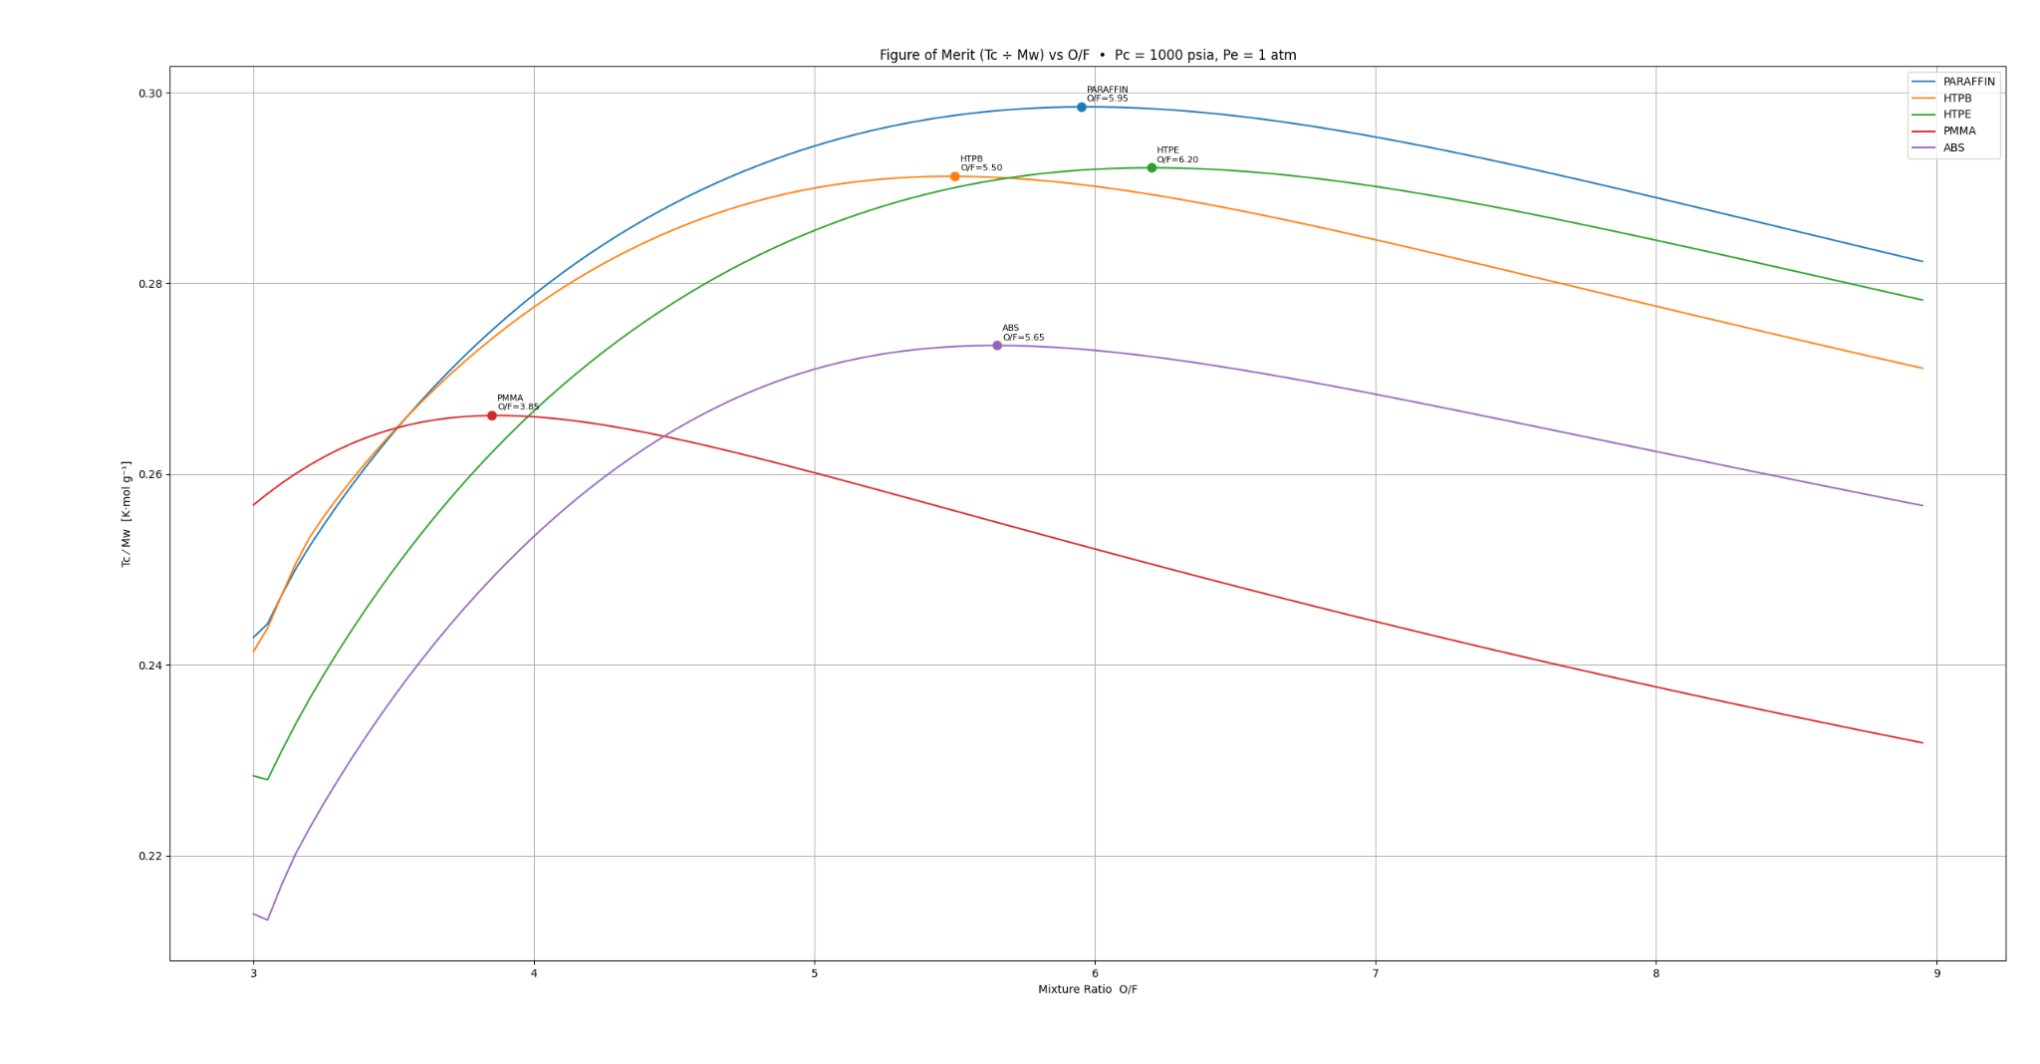
Design Parameters
Target Pressure - 440 PSI - Result of requirements 2.2 and 2.4, see pressure budget
o/f ratio = 6
Preliminary calculations showed that with these constraint 38mm, and 54mm motors where possible.
54mm(2.13”) was eliminated due to the thin fuel grain (<5mm (0.2”) thick) => design is to be compatible with 38mm (1.5”) hardware
Fuel was chosen to be paraffin wax due to its combination of energy density, high o/f ratio, affordability
Oxidizer to fuel estimate from IREC 2027 Rocket sizing tool using Rocket CEA
By: Nicholas Quillin
Current Speaker: Mr. Aero Mavs
Next Speaker: Ms. Aero Mavs
Notes:
Speakers: karthik talks first two slides jonathan will talk chamber assembly and nozzle subassembly, forward closure.

Slide 48
Paraffin Wax
Paraffin wax is a byproduct of the oil refining process and is composed of long alkanes between 20-40 carbons in length.
Paraffin is often confused with Microcrystalline wax which is better known as petroleum wax which combines the long alkanes of paraffin with branched-chain, and cyclic hydrocarbons.
The longer length of paraffin results in reduced viscosity of propellant.
Paraffin Wax
Petroleum / Microsyllicate Wax

Slide 49
ProPEP analysis
Preliminary low fidelity model to calibrate main model against.
Paraffinic oil suggests that this is actually Microcrystalline wax.
guiPEP
By: Pablo Martinez
Date: 9.23.2025

Slide 50
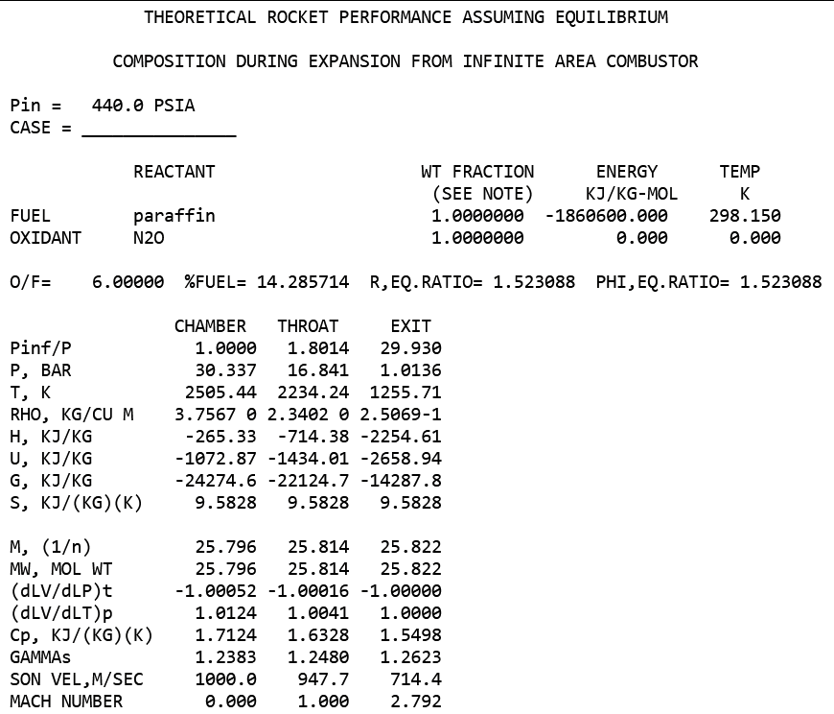
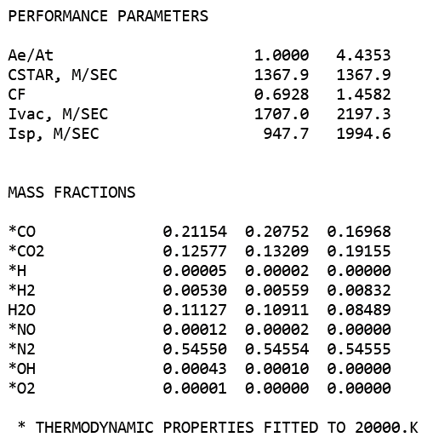
CEA analysis
Manual CEA predicts higher ideal O/F ratio then either Sutton or RocketCEA python wrapper. Still trying to figure out why this is the case
Chamber temperature is lower than PeP, these conservative values are used for thrust calculations while PEP results are used for heat flux
This translates to approx 203s of specific impulse, significantly lower than many reference material on this subject. It might be due to the composition of paraffin defined by the software
Since this model takes in account shifting chemical equilibrium, these values are used for the respective performance of the nozzles over PeP
Exhaust properties cross referenced with performance properties using excel
NASA CEA
By: Nicholas Quillin
Date: 10.25.2025
Current Speaker: Mr. Aero Mavs
Next Speaker: Ms. Aero Mavs
Notes:
Factor of safety increased - main point of failure to test. Weight is not main point
(Stainless) Steel is disallowed in combustion chamber by tripoli regulations (is still a pressure chamber that could explode and create shrapnel)
Double check with tripoli houston

Slide 51
Sizing
Injector Sizing
2 holes,
Cut from ½” National pipe thread plug
Grain sizing results:
Total Impulse = 1000 Ns
Average Force = 153 N
Maximum Oxidizer Mass Flux = 384 kg/m^2
Oxidizer Mass flow = 66.9 g/s
Grain Length= 11.99cm
Grain outer diameter = 33.32mm
Grain inside Diameter= 14.87 mm
Constraints:
The engine shall not exceed 2000 Ns of total impulse
The Combustion chamber should be primarily produced from COTS hardware with minimum machining
Oxidizer Mass flux shall not exceed 600kg/m^2
Regression rate coefficients based on data collected by
Lee, T.-S., and Tsai, H.-L., “(PDF) fuel regression rate in a paraffin-HTPB nitrous oxide hybrid rocket,” Research Gate Available: https://www.researchgate.net/publication/268343388_Fuel_Regression_Rate_in_a_Paraffin-HTPB_Nitrous_Oxide_Hybrid_Rocket.
Current Speaker: Mr. Aero Mavs
Next Speaker: Ms. Aero Mavs
Notes:
Nozzle -> Speaker: N||J

Slide 52
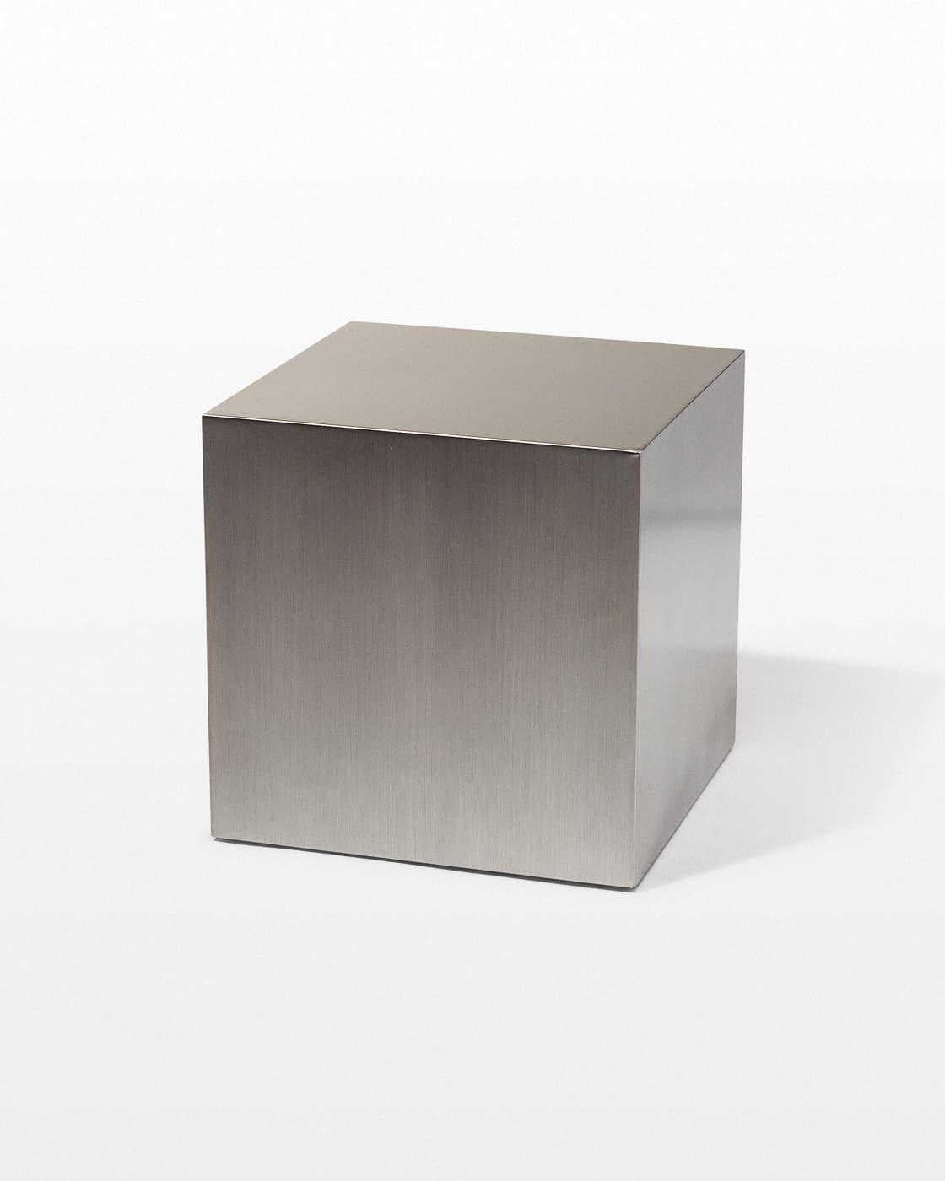
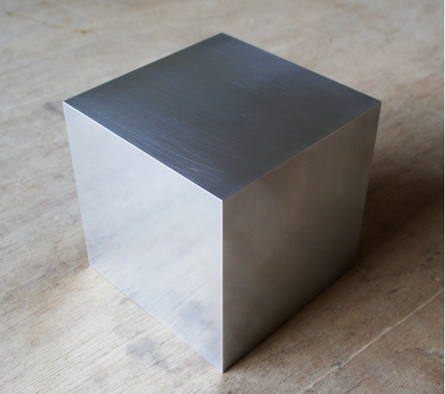
Material
6061 Aluminum for combustion chamber assemble
Pipe fittings are stainless steel
316 Steel - Eliminated because it violates the unified tripoli safety code
FastenersWEB, “Aluminum cube 6061 T6 suppliers, manufacturers, exporters from India - FastenersWEB,” fastenersweb.com Available: https://www.fastenersweb.com/proddetail/68007/aluminum-cube-6061-t6.
“TB057 16" stainless steel cube prop rental,” ACME Brooklyn Available: https://www.acmebrooklyn.com/prop/tb057-small-stainless-steel-cube/.

Slide 53
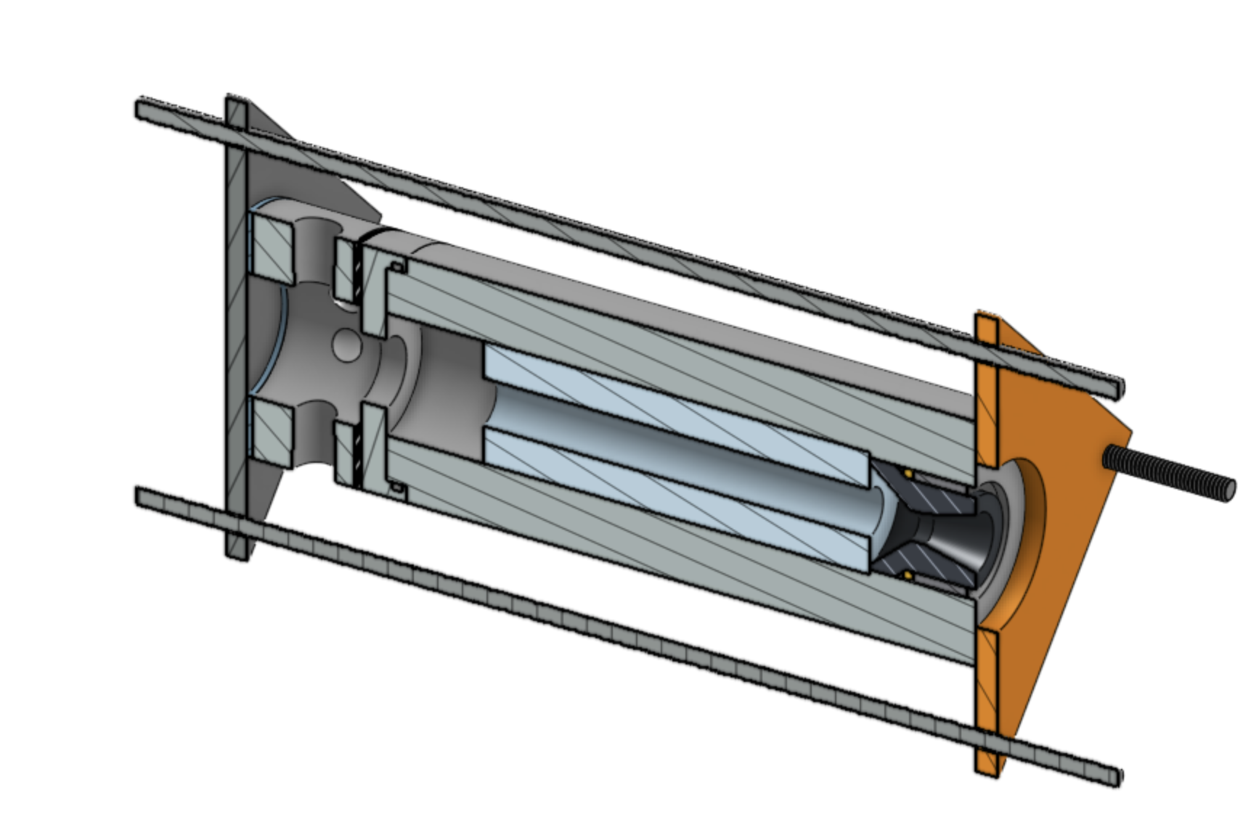
Chamber Assembly
Chamber is fabricated from a 3 in diameter 6061 aluminum tube. It is radiatively cooled. The radiatively cooled chamber configuration was chosen for its simplicity, and low cost capability.
3” was chosen as the smallest size which would allow the engine to run cool even with a failure to shut off the engine.
The Combustion chamber utilizes as many COTS components as possible to supplement the machined parts for cost reduction purposes.
Model is made through Onshape
By: Jonathan White
Date: 10.17.2025
Current Speaker: Mr. Aero Mavs
Next Speaker: Ms. Aero Mavs
Notes:
Speaker: N||J

Slide 54
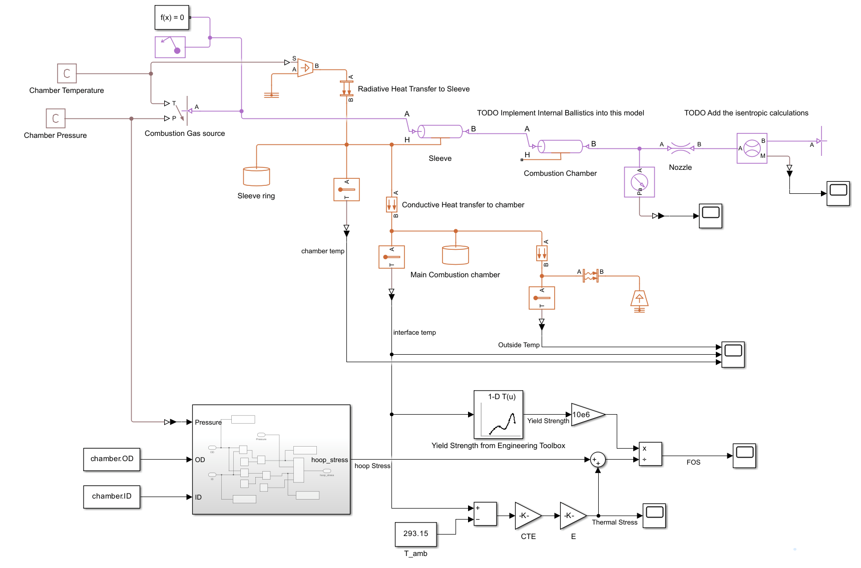
Chamber Stresses
To ensure that the chamber would not fail, chamber stresses where calculated using 2 approaches
Worst case heating (assumptions adiabatic heating) calculated in MATALB using ODE45.
In-Dev chamber model assuming equilibrium with atmosphere that will be improved using data collected.
Models where very similar with about 35C final temp difference.
Equations used
Thick-Wall Hoop stress formula.
Convection/Conduction formula from thermal mech.
Boltzmann Radiation formula
Stress from solid mech.
Thermal Strain from solid mech.
In-Dev Chamber model in simulink
By: Nicholas Quillin
Date: 10.16.2025

Slide 55
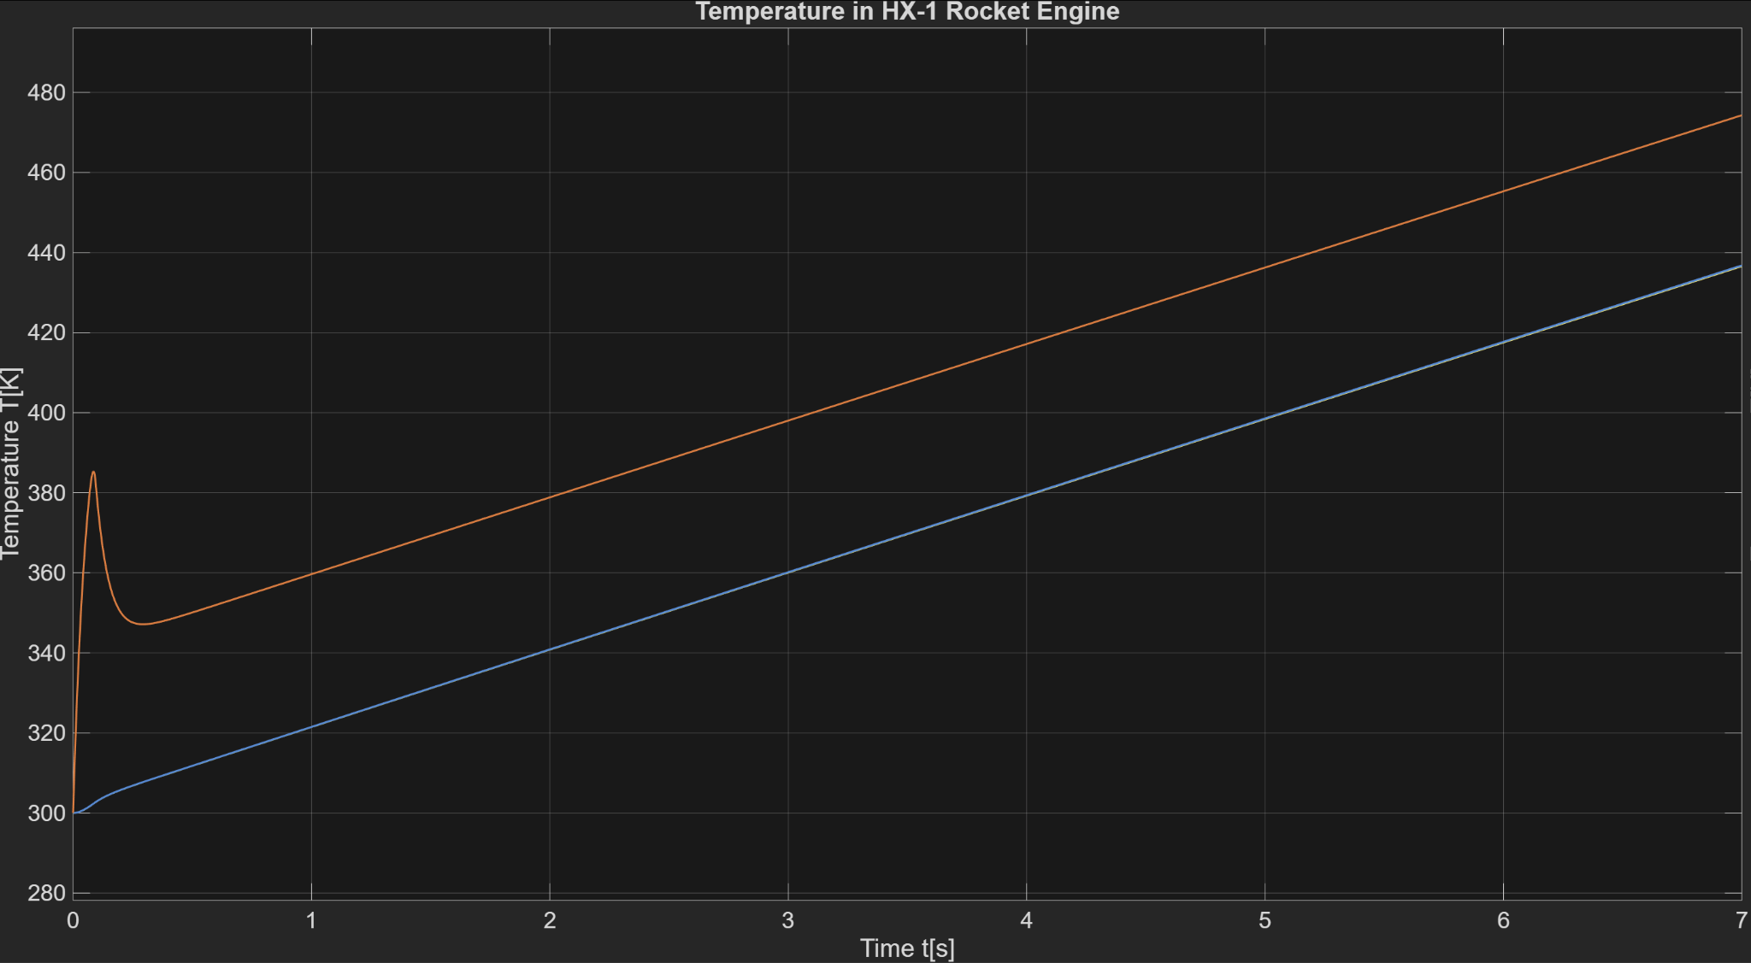
Thermal Protection System
Model assumes heat from the combustion gasses primarily travels through convection and radiation which is based on pretty much all available literature.
A simple metal sleeve (in red) slows down the heating experienced by the rocket engine chamber (in blue).
Maximum chamber temperature is under 140 C making it compliant with TRA and NFPA.
The chamber can absorb the heat from a full 6s burn in the case oxidizer system fails open.
Diagram made by: Nicholas Quillin
Date:
Software:
Sources:
Current Speaker: Mr. Aero Mavs
Next Speaker: Ms. Aero Mavs

Slide 56
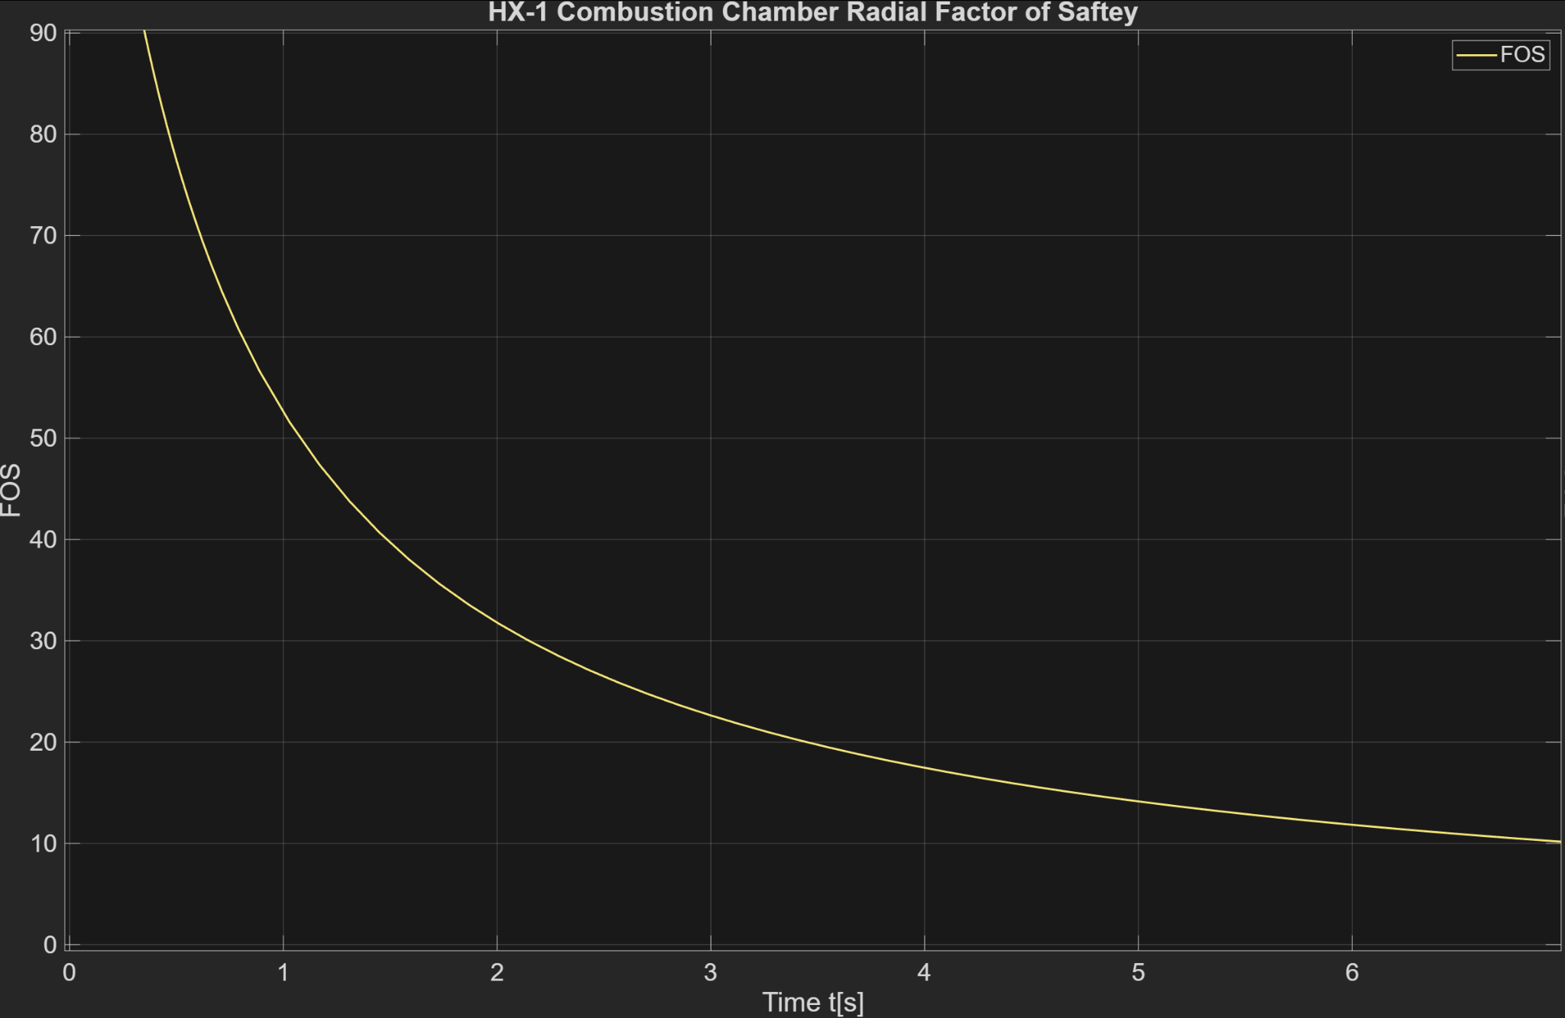
Chamber Stress
The chamber stress combines mechanical and thermal stresses and considers thermal weakening
The Stress of the system is far lower than the intended FOS.
Minimum FOS is over 10
Diagram made by: Nicholas Quillin
Date:
Software:
Sources:
Current Speaker: Mr. Aero Mavs
Next Speaker: Ms. Aero Mavs
Notes:
Definitely needs way more detail
How did we do this
What was considered
What equations
Where equations from (textbooks)

Slide 57
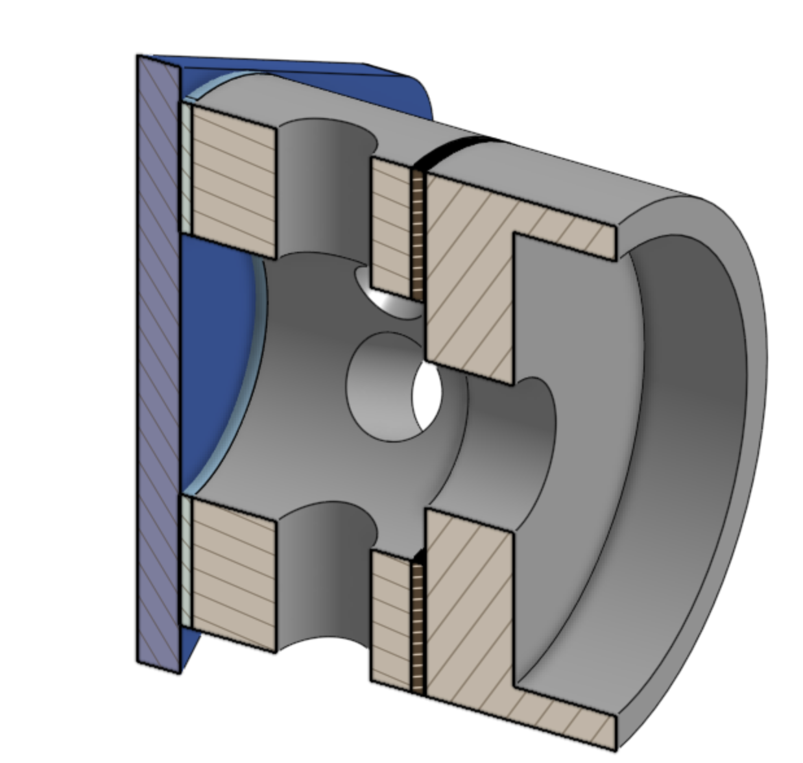
Forward Closure Subassembly
The forward closure is designed to be modular and readily upgradable.
The injector is mounted to the injector plate that is mounted between the NOX manifold and chamber.
In the future we plan on using this to test a pintle injector design.
Model is made through Onshape
By: Jonathan White
Date: 10.17.2025
Current Speaker: Mr. Aero Mavs
Next Speaker: Ms. Aero Mavs
Notes:
Speaker: N||J

Slide 58
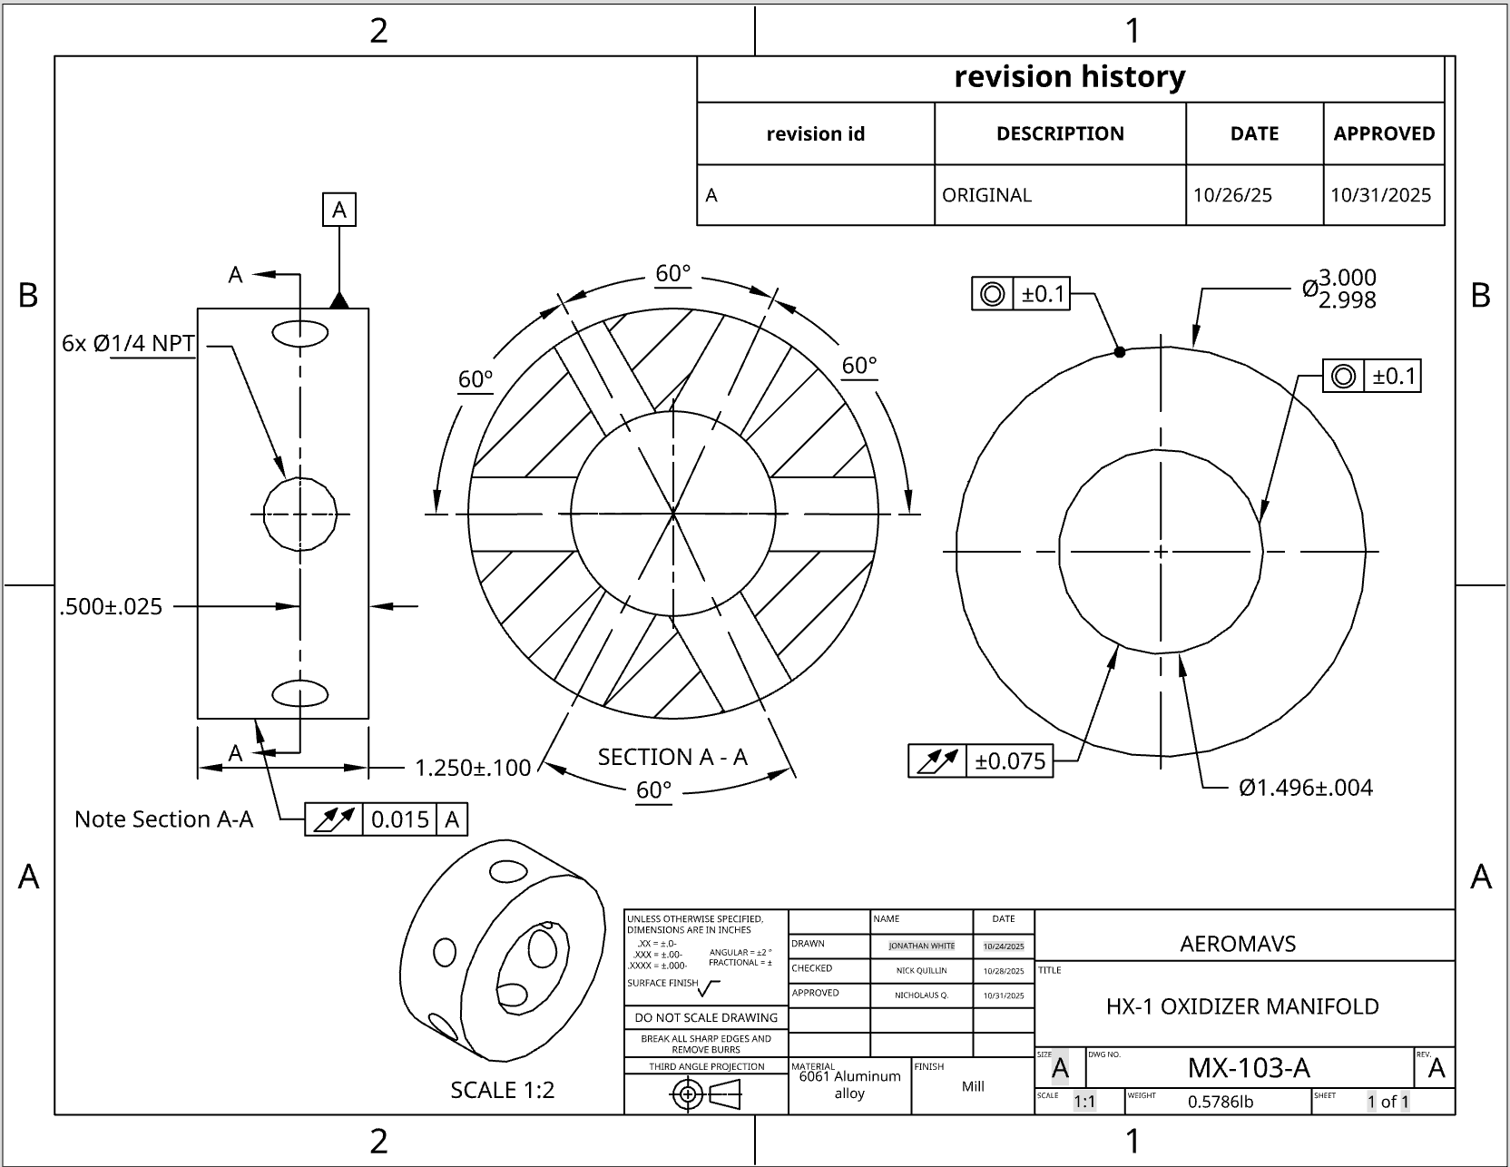
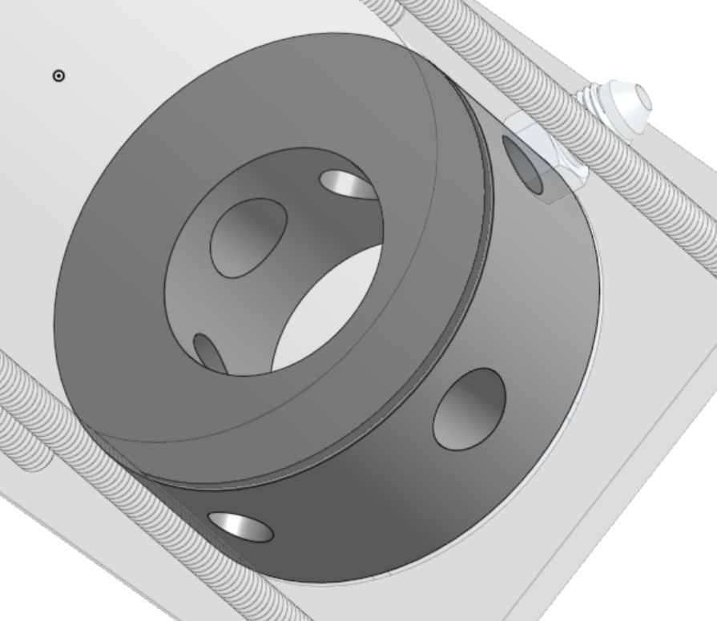
Intake Manifold
Intake manifold has six ¼NPT ports for various uses.
1x Pressure Ports
1x Temperature Ports
2x Nitrogen Extinguishing Line
2x Nitrous Feed Line
The use of 2 gas injection ports adds a level of redundancy if one gets blocked.

Slide 59
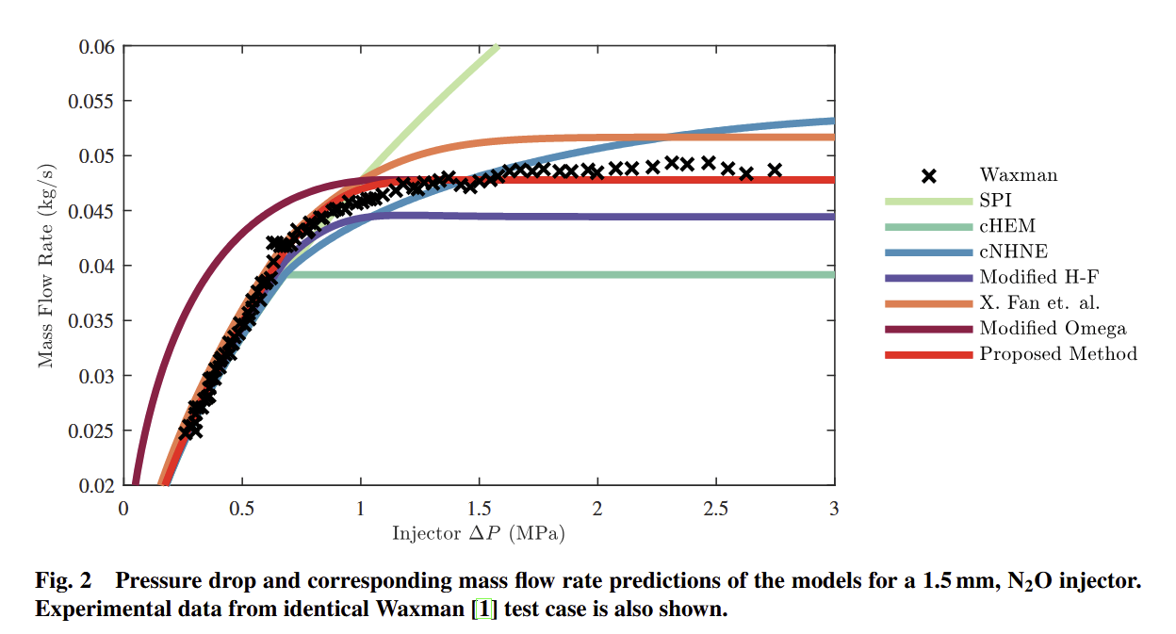
Injector Sizing
Due to the limitations of modelling we are not exactly sure how the flow will behave through inlets.
Single Phase Incompressible (SPI): Traditional model used as first order approximate. Does not consider phase changes. Over estimates flow.
Homogeneous Equilibrium Model (HEM) : Models the flow through the conservation of flow work. Assumes that the gas is always in equilibrium with external flow. Under estimates flow.
Dyer Combined Model : Empirical combination of HEM and SPI that requires data.
Before conducting engine test, the flow rate will have to be determined and the closest match to the desired flow rate must be found through experimentation.
*From Design of Two-Phase Injectors Using Analytical and Numerical Methods with Application to Hybrid Rockets by Nino and Razavi

Slide 60
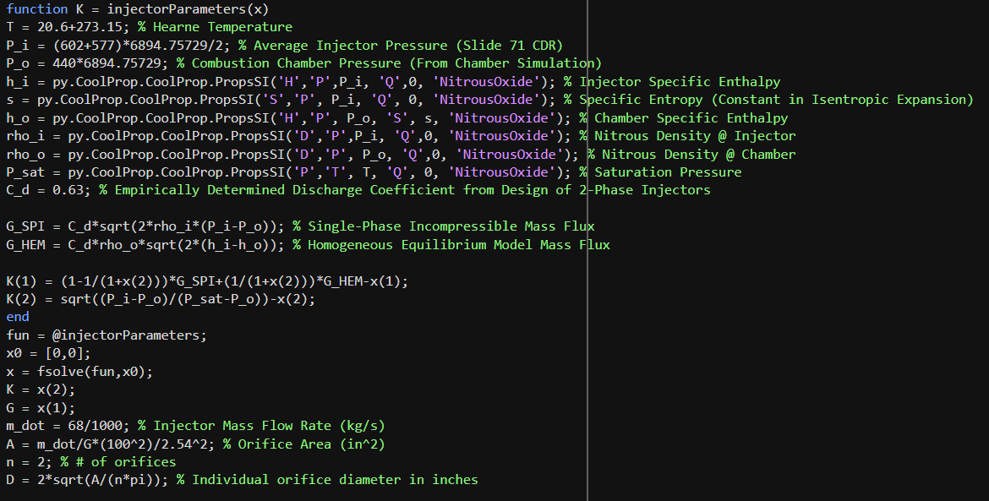
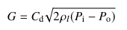
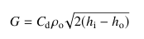
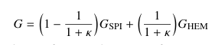
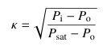
Injector Orifice Sizing
Using the Non-Homogeneous Non-Equilibrium (NHNE) Model (Niño and Razavi, 2019), the mass flux (G) and non-equilibrium parameter (K) were modeled using Matlab code & CoolProp thermodynamic properties of Nitrous.
Inlet & outlet pressures were calculated from earlier ProPEP & thrust chamber simulations in Pascals.
Assumed afternoon temperature for Hearne, Texas, in Kelvin.
Inlet enthalpy calculated using inlet pressure and mixture quality of 0 (flow initially assumed to be only liquid).
Outlet enthalpy calculated by assuming constant entropy from isentropic expansion of liquid Nitrous & outlet pressure.
Inlet & outlet densities calculated using respective pressures and quality of 0, with outlet density representing Nitrous state just before flash boiling.
Liquid discharge coefficient of 0.63 was used, as it is typically utilized for the NHNE model (Niño and Razavi, 2019).
Program utilized inputs to calculate G_SPI & G_HEM, then used fsolve using the residuals of the NHNE flux & Non-Equilibrium Parameter equations (2 equations & 2 unknowns) to find G and K.
Injector mass flow rate assumed to be 68 g/s from thrust chamber simulation.
All units in the program inputs and outputs were converted to SI units, with the exception of A and D such that comparisons to imperial drill bit sizes could be made.
Results:
K = 0.703
G = 3.07e+04 kg/(m^2 s)
A = 0.0034 in^2
D = 0.0467 in
2 orifices of individual diameters 0.0467 in necessary to facilitate MFR.
Single Phase Incompressible Model (SPI) Flux
Homogeneous Equilibrium Model (HEM) Flux
NHNE Model (average of SPI & HEM) Flux
Non-Equilibrium Parameter Equation
Niño, E. V., and Razavi, M. R., “Design of Two-Phase Injectors Using Analytical and Numerical Methods with Application to Hybrid Rockets,” AIAA Propulsion and Energy 2019 Forum, Indianapolis, IN, Aug. 2019. AIAA Paper 2019-4154. https://doi.org/10.2514/6.2019-4154

Slide 61
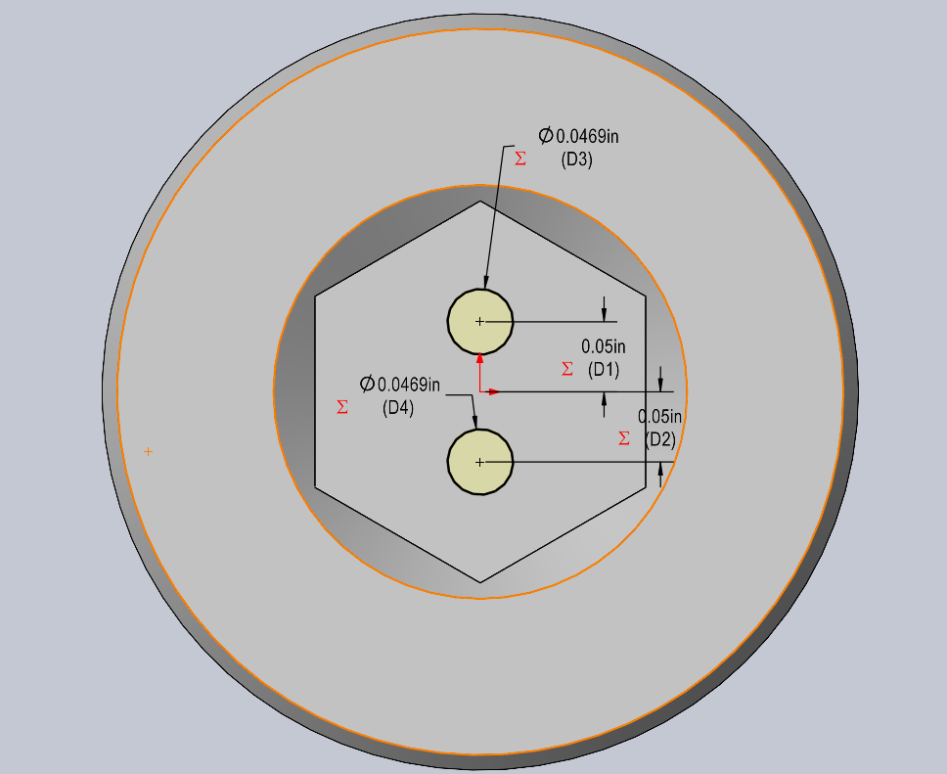
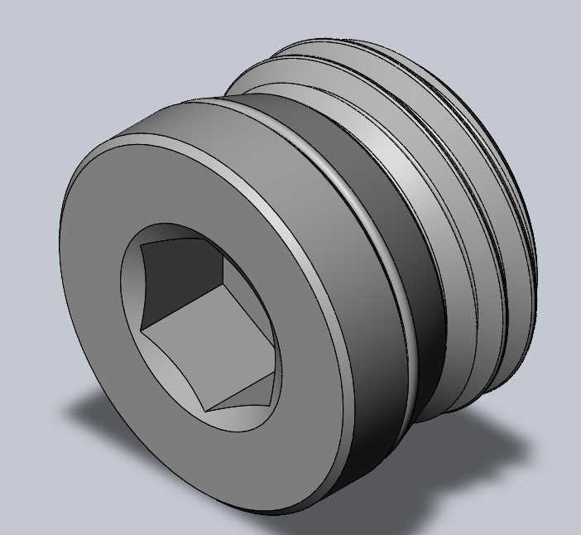
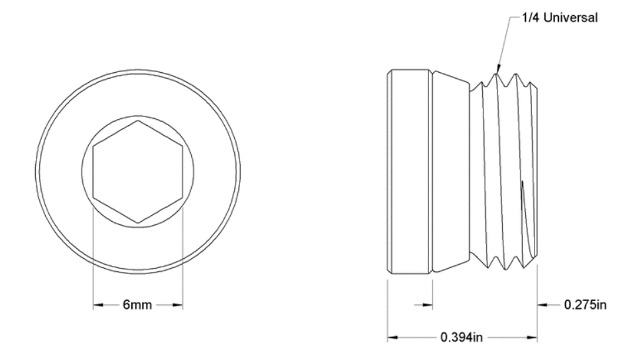
Injector Design
In order to facilitate the prototyping of various injectors, the injectors will be removable.
The first injector iteration will be machined out of a Nickel-Plated Brass Pipe Fitting Plug with Hex Drive, 1/4 Universal Male.This will simplify the machining process of the injector such that only the orifices will need to be drilled.
2 holes of drill bit size 3/64 in will be drilled into part for orifices.
Drill bit size was chosen because 3/64 in diameter is equivalent to approximately 0.0469 in, which serves as a close approximation to the previously calculated diameter of 0.0467 in.
Distance between orifices was set to be 0.1 in. This was chosen arbitrarily for the sake of geometrical simplicity.
For future research this part can be replaced with a pintle.
McMaster-Carr. "Nickel-Plated Brass Pipe Fitting, Plug with Hex Drive, 1/4 Universal Male." McMaster-Carr, n.d. https://www.mcmaster.com/4948N25/ (accessed Nov. 5, 2025).
Current Speaker: Mr. Aero Mavs
Next Speaker: Ms. Aero Mavs

Slide 62

Nozzle Subassembly
A phenolic resin cast wide bore nozzle: 0.375”(9.525mm) throat diameter from RCS.
The retaining system involves a Nylon 3D printed ring and shear pin that is designed to shear around 800 psi.
To seal the nozzle we incorporate a high-temp O ring between the nozzle lip and the retaining ring to control the flow of gas exiting the nozzle.
Model is made through Onshape
By: Jonathan White
Date: 10.11.2025
Current Speaker: Mr. Aero Mavs
Next Speaker: Ms. Aero Mavs
Notes:
Speaker: N||J

Slide 63
Nozzle Failure System
Of the various systems considered the shear pin was chosen as the simplest and most practical method
 | Cost | Analytical Complexity | Practical Considerations
Shear Pin | Medium | Low | Must be uniform Retention mechanism
Standoff | Medium | Medium Stress concentrator analysis | Machining Screw cannot strip before failure
Retaining Ring | Low | High FEA required | Groove may be worn down after repeated use

Slide 64

Retention Analysis
Due to the hardness and toughness of the pin, a drill bushing was added to distribute the force.
Simple analysis was done using solid mechanics textbook.
Assumptions
The maximum bearing force the chamber would have to withstand was the maximum failure condition of 1300lb
The Curved surface was approximated by a unwrapped plate with uniform rectangular cross sections
The bushing is perfectly rigid, as the aluminum is much softer then the bushing
The force is distributed along the surface based off of the normal angle => maximum stress was at the bottom most part of the hole.
FOS 3.06 was calculated for 6061 T6 Aluminum
Highest Stress element mohr's circle
By: Nicholas Quillin
Date: 10.11.2025

Slide 65

Shear pin Mechanical Testing
In order to characterize the performance of the combustion chamber we are limiting the combustion chamber to have a max of 800 psi, and that results in an axial load of 5200N on the shear pins.
To test this we can place pressure on the combustion chamber and press it against the nozzle and shear pins and test at the limit it fractures.
Shear Mechanical Test Procedure:
Clear test stand.
Connect load cell normal to the engine (with nozzle and shear pins connected).
Zero the load cell, and begin the test by applying continuous increasing water pressure until the the shear pins fracture allowing the nozzle detach from the main combustion chamber.
Check the data and damage from the shear test.
Model is made through Onshape
By: Jonathan White
Date: 10.28.2025
Current Speaker: Mr. Aero Mavs
Next Speaker: Ms. Aero Mavs

Slide 66

Sealing and structure
“O-Ring Groove Design | Global O-Ring and seal,” Global O-rings and SEAL Available at: https://www.globaloring.com/o-ring-groove-design/.
Engineering Drawing made on Onshape
By: Jonathan White
Date: 10.25.25
The forward closure has 2 gaskets forward and aft consisting of gaskets rated for 2000 psi.
The combustion chambers sealing mechanism is a dual radial seals.
Current Speaker: Mr. Aero Mavs
Next Speaker: Ms. Aero Mavs

Slide 67
Machining
Machine shop lab - Will machine our Combustion chamber casing.
Protospace Mfg - $1000 of credits Combustion chamber and forward closure.(3 day lead time)
Shear pins (open to discussion)
We will order all parts 2-3 weeks ahead of time
Nozzle Retaining ring
Oxidizer Manifold
Current Speaker: Mr. Aero Mavs
Next Speaker: Ms. Aero Mavs

Slide 68

Ignition Subassembly
Ignition stub using nichrome wire - simplest as many licensing rocket use these and are within the standard of Tripoli.
Future plan for ignition subassembly:Referencing Benjamin Letourneau’s (et.al.) research from the University of New Hampshire on a hybrid engine ignition subassembly.
Cite:Letourneau, B., Blampied, T., Johnson, M., and Pham, T., “Hybrid rocket engine ignition and control,” University of New Hampshire Scholars Repository Available: https://scholars.unh.edu/honors/481/?utm_source=scholars.unh.edu%2Fhonors%2F481&utm_medium=PDF&utm_campaign=PDFCoverPages.
Apogee Components, I., “Apogee components - first fire starter for High Power Motors,” Model Rockets & How-To Rocketry Information Available: https://www.apogeerockets.com/Rocket_Motors/AeroTech_Accessories/First_Fire_Starter?cPath=7_160&.
Current Speaker: Mr. Aero Mavs
Next Speaker: Ms. Aero Mavs
Notes:
COTS

Slide 69
Summary -

Slide 70
Fluid System
The fluid system design encompasses the design of the oxidizer, filling, and any other pressurized fluids.
Current Speaker: Mr. Aero Mavs
Next Speaker: Ms. Aero Mavs
Notes:
Pablo and Joel

Slide 71

Nitrous oxide
Nitrous oxide was chosen because:
Only legal oxidizer for IREC
Has been demonstrated by other amateur groups (RICE and Half Cat)
Safety
Procurable
Safety cabinet in AeroMavs lab
Woolf Hall 113
Current Speaker: Mr. Aero Mavs
Next Speaker: Ms. Aero Mavs

Slide 72

Plumbing system
3 main assemblies, the main nitrous line, the secondary nitrogen gas extinguishing line, manual pump from DI water source.
Measuring the upstream /tank pressure with pressure transducer and tank pressure
Redundant valves allow to recover test from valve failures inspired by apollo lunar descent system
Diagram made by: Nicholas Quillin
Date:11.3.2025
Software:
Current Speaker: Mr. Aero Mavs
Next Speaker: Ms. Aero Mavs

Slide 73

Operation Loop
Igniter will be attached through secondary port in order to pr.
Cold flow test will be identical to hotfire except without the ignition charge. It will be used to characterize the blowdown of the Nitrous tank.
Diagram made by: Nicholas Quillin
Date:11.3.2025
Current Speaker: Mr. Aero Mavs
Next Speaker: Ms. Aero Mavs

Slide 74

Cool Down Loop
In order to take accurate measurements of fuel regression and prevent melting of the fuel grain, Nitrogen gas will be introduced into the chamber through the cooldown subsystem.
Diagram made by: Nicholas Quillin
Date:11.3.2025
Current Speaker: Mr. Aero Mavs
Next Speaker: Ms. Aero Mavs

Slide 75


Pressure Profile
Pressure blowdown Calculated via conservative linear dP/dx = 0.7 from Humble textbook
Similar hybrid engines have dP/dx of 0.75
Nitrous express uses dP/dx = 0.8 on promotional material
Adiabatic tank simulation predicts dP/dx = 0.72
Current Speaker: Mr. Aero Mavs
Next Speaker: Ms. Aero Mavs
Notes:
Change of pressure over vapor quality

Slide 76


Valves
Main valve 18018NOS Nitrous racing valve
$114 much more affordable than industrial valves
Tested for use with saturated Nitrous oxide
Made to run off 12V DC car batteries, simplifying power train
¼”NPT to ⅛”NPT reduces number of fittings
3/32” orifice
Mcmaster carr High pressure ball valves
Very affordable with high pressure rating
Fluoroelastomer seals
All Bleed valves
Servo Actuated ball valves
Proven in HCR 5100 System
Current Speaker: Mr. Aero Mavs
Next Speaker: Ms. Aero Mavs
Notes:
Joel

Slide 77
Actuator Testing Procedure
PPE Required
Lab Coat
Safety Glasses
Gloves
Setup
Ensure all PPE is on.
One person will need to be observing the test, while another operates the testing hardware. All persons will need to be at least 30 feet away from the nozzle (in the case of testing at higher pressures) and behind the testing apparatus.
The person conducting the test should ensure the system is properly assembled (pipe fitting SOP for reference) and that sensors are nominal. The load cells should read their predicted values, pressure transducers should read zero psig, and thermocouples should read ambient temperature.
If any deviations are observed from anticipated measurements, the device should be recalibrated before beginning the test.
All valves will initially be CLOSED before undergoing the test.
At no point should the Maximum Expected Operating Pressure be exceeded.
Procedure
Open the valves for the Nitrogen tank and set the regulator to 100 psig, filling the system with Nitrogen gas and allowing for purging.
Actuate the oxidizer fill valve and then de-actuate it. The observer will communicate to the tester if the actuation was successful or not.
Actuate the Run Tank venting valve and then de-actuate it. The observer will communicate to the hardware tester whether the actuation is successful or not.
Actuate then de-actuate the Flow Control valve into the combustion chamber. The observer will communicate to the hardware tester whether the actuation is successful or not.
Actuate then de-actuate the combustion chamber valve. The observer will communicate to the hardware tester whether the actuation is successful or not.
Current Speaker: Mr. Aero Mavs
Next Speaker: Ms. Aero Mavs

Slide 78
Actuator Testing Procedure
Unsuccessful actuation procedure
If an actuation is unsuccessful at any point, the system dump valve will be opened, and the pressure source will be shut off. The valve will then need to be troubleshooted before restarting the test from the point of failure.
Valve troubleshooting: After shutting off all pressure sources and draining the system, the valve will be remotely actuated again. If this does not work, a mechanical actuation must be attempted to inspect for any mechanical failures/freezing in the valve. If there is no mechanical failure or freezing, the person in charge of the hardware will approach the testing apparatus to ensure the component is receiving voltage from the valve controller.
Restart the test after successful troubleshooting or disconnection from the system. If troubleshooting is unsuccessful, either the component or the controller will need to be replaced, depending on whether the failure source is the valve or the control system.
After all components are verified to successfully actuate, drain the system, and shut off the pressure source, if no other testing is to be done. If undergoing other tests, keep the valves active for leak/hydrostatic testing.
Current Speaker: Mr. Aero Mavs
Next Speaker: Ms. Aero Mavs

Slide 79
Fittings and Connectors
Sourced from McMaster carr with various sizes
Main feed line goes from ¼” to ⅛” at the inlet
National Pipe Thread (NPT) attachments are semi-permanent
Flared fittings used for parts that are frequently disconnected and and reconnected.
Brass fittings are preferred because their NPT threads will not scratch steel threads allowing expensive components to be reused.
Current Speaker: Mr. Aero Mavs
Next Speaker: Ms. Aero Mavs

Slide 80


Electronic Sensors
Used to measure real-time response
WIKA A-10 Pressure Transducer
Already available stock
Precalibrated and rated to 1000 psi
4-20 mA signal
K Type thermocouple
Oxidizer temperature monitoring
-6-20 mV signal
Current Speaker: Mr. Aero Mavs
Next Speaker: Ms. Aero Mavs

Slide 81

Physical Sensors
In addition to the analog sensors, analog sensors are used as a low cost alternative where precise, time sensitive data is not needed.
Analog pressure gages recorded via video capture on smartphones, and processed through vernier video analysis or python.
Current Speaker: Mr. Aero Mavs
Next Speaker: Ms. Aero Mavs

Slide 82

Pressure Safety System
The system only has one place where liquified gas can accumulate which is equipped with a safety pressure relief valve to prevent from system going critical
Used 1000 psi adjustable pressure relief valve from previous year REU project.
All trap points are also equipped with manual ball pressure relief valves.
Current Speaker: Mr. Aero Mavs
Next Speaker: Ms. Aero Mavs

Slide 83


Hydrostatic Testing Loop
A hydrostatic test can be used to validate system can maintain pressure. First 4 test nondestructive, 5th test is destructive of the chamber.
Using a REX 6GDU5 hydrostatic pump to reduce variance from grainger.
Monitor pressure drops on transducers to ensure that the system has no leaks
50’ standoff distance
Current Speaker: Mr. Aero Mavs
Next Speaker: Ms. Aero Mavs

Slide 84
Hydrostatic Testing Loop
Current Speaker: Mr. Aero Mavs
Next Speaker: Ms. Aero Mavs

Slide 85
Cold Flow and Blowdown Testing
A Nitrous Cold flow test will be conducted to ensure system functions as intended & to observe the blowdown of the tank.
Pressure transducer on Nitrous fill line will be monitored to get pressure data over time.
Dump valve on fill line should be opened at any point to vent excess pressure.
50’ standoff distance
Current Speaker: Mr. Aero Mavs
Next Speaker: Ms. Aero Mavs
Notes:
ADD COLD FLOW PROCEDURE

Slide 86

Compressed Gasses Sourcing
We can use disposable co2 cartridges for initial tests
Nitrous fill at start of day
10 lb Nitrous tank is large enough to be good for multiple tests. (Summit racing, Arlington Texas)
Cite: https://www.summitracing.com/
Current Speaker: Mr. Aero Mavs
Next Speaker: Ms. Aero Mavs

Slide 87

Nitrous Oxide Safety
Precautionary Statements
Read label before use. Keep out of reach of children. If medical advice is needed, have product container or label at hand. Close valve after each use and when empty. Use equipment rated for cylinder pressure. Do not open valve until connected to equipment prepared for use. Use a back flow preventative device in the piping. Use only equipment of compatible materials of construction. Open valve slowly. Use only with equipment cleaned for Oxygen service. Always keep container in upright position.
Signal Word DANGER
Hazards May cause or intensify fire; oxidizer. Contains gas under pressure; may explode if heated. May cause drowsiness or dizziness. May displace oxygen and cause rapid suffocation.
* Nitrous SDS

Slide 88

Nitrous Bottle Storage
No Nitrous filled tank will be stored on campus.
Nitrous bottle fill before testing
Nitrous used in cold flow test
Nitrous used in hot fire
Nitrous blowdown and fully vented
Capped and sealed in closet empty.
WH113 is well ventilated with 8 ACH rating.
Current Speaker: Mr. Aero Mavs
Next Speaker: Ms. Aero Mavs
Notes:
Joel

Slide 89
Oxygen Cleaning
Begin by cleaning as much as possible in a nonionic detergent bath
Ultrasonic clean with nonionic detergent
Triple rinse with DI water to dissolve surfactants
Ultrasonic clean with DI water in order to remove entrapped surfactants
Transfer to Isopropyl bath to dissolve water.
Place in toaster oven at 60 C
Where did we get this cleaning method?
Was it approved by EHS?
Current Speaker: Mr. Aero Mavs
Next Speaker: Ms. Aero Mavs
Notes:
PABLO
Reflow Machine @ EE Makerspace (Maybe. Don’t mention in presentation)

Slide 90


Cleaning Solvents
Crystal simple green
Widely available and affordable
Nonionic surfactants reduce the residue left behind
1-2% mixture
Safe to handle
Still leaves residue that must be removed
DI water
Easily available at UTA labs
Reduced residue
Protects parts from airborne particles
Wash away surfactants
If not removed properly can cause icing conditions
ACS grade Isopropyl Alcohol
Leaves practically no residue
Highly volatile helping it easily be evacuated through bake
Current Speaker: Mr. Aero Mavs
Next Speaker: Ms. Aero Mavs
Notes:
PABLO

Slide 91

Ultrasonic Cleaner
Ultrasonic cleaner from Amazon
Allows for deep penetration for grease, oil, and leftover surfactants.
For use with detergent and DI water ONLY
IPA fumes in the machine are dangerous and due to the heater element is a fire risk.
Image source:
Current Speaker: Mr. Aero Mavs
Next Speaker: Ms. Aero Mavs

Slide 92

IPA Safety
Precautionary Statements Prevention Wash face, hands and any exposed skin thoroughly after handling Do not breathe dust/fume/gas/mist/vapors/spray Use only outdoors or in a well-ventilated area Keep away from heat/sparks/open flames/hot surfaces. - No smoking Keep container tightly closed Ground/bond container and receiving equipment Use explosion-proof electrical/ventilating/lighting equipment Use only non-sparking tools Take precautionary measures against static discharge Wear protective gloves/protective clothing/eye protection/face protection Keep cool
Signal Word DANGER
Hazards Highly flammable liquid and vapor Causes serious eye irritation May cause respiratory irritation May cause drowsiness or dizziness May cause damage to organs through prolonged or repeated exposure
* IPA SDS

Slide 93


IPA Safety Cont.
PPE
Avoid skin contact by wearing gloves. Wear a respirator equipped with a organic vapours (OV) filter.
Response
IF INHALED: Remove person to fresh air and keep comfortable for breathing. Call a POISON CENTER or doctor if you feel unwell. IF ON SKIN (or hair): Take off immediately all contaminated clothing. Rinse skin with water. IF IN EYES: Rinse cautiously with water for several minutes. Remove contact lenses, if present and easy to do. Continue rinsing. If eye irritation persists: Get medical advice or attention.
Storage Store locked up. Store in a well-ventilated place. Keep container tightly closed. Keep cool.
Disposal Dispose of contents and container in accordance with all local, regional, national and international regulations.
Current Speaker: Mr. Aero Mavs
Next Speaker: Ms. Aero Mavs
* IPA SDS
Notes:
IPA Fumes are very flammable, So our procedure was altered to accommodate this

Slide 94
Summary -

Slide 95

Test Stand
Model Made on Solidworks by AeroMavs Hybrid Division
Date:
Current Speaker: Mr. Aero Mavs
Next Speaker: Ms. Aero Mavs

Slide 96


Test Stand
Test stand rated for 1000 Ns of force
The dimensions are 66”x24”x6.5”.
Instrumentation package
The control hardware is aft of the vertical thrust beam.
Current Speaker: Mr. Aero Mavs
Next Speaker: Ms. Aero Mavs
Notes:
Speaker NOTES:
Utilizes Rice University’s bolt anchor layout at Hearne. The test stand was designed to use two of the closest bolt locations. Designed narrow and close to ground to reduce torque produced. Anchor points should more than suffice for anchoring needs as they were used for a much larger test stand. 1) TEST STAND RATED FOR 1000 Ns force, with a safety factor of 3 using COTS components so the total force it can handle before failure is 3000 newtons
1.5) Designed to allow multiple motors with different fuel mixtures to be tested
2) Designed and built in house to be easily transportable and low cost
3) instrumentation package: s-type load cell, pressure transducers for both combustion chamber and feed lines, beam load cells for tank weight measurement
4) The main control hardware is aft of the vertical thrust beam, such as the servo actuated ball valve, emergency pressure relief valve, and the DAQ and main electronics. [explain more if needed]
TODO:
Change the 3d printed plates to aluminum
Extend the spacing of the nitrous tank and vertical frame for safety (separating the burn area from components)
Might need to use another anchor bolt?
Change angle of Nitrogen tank
Find out optimal angle
Look at Lavinia’s suggestion on Teams chat
Figure out height of the motor plate for the motor’s centerline to be in line with the load cell

Slide 97

Configuration
The configuration was chosen because:
Test facility anchoring points were available from previous test fires by Rice University’s Eclipse team
Cost factors: Majority of components were available in the AeroMavs stock.
Design safety factor (81.5).
Ease of fabrication and testing.
Model Made on Onshape by AeroMavs Hybrid Division
Current Speaker: Mr. Aero Mavs
Next Speaker: Ms. Aero Mavs
[4] Newlands, R. M., Science and design of the Hybrid Rocket Engine, Lulu, 2017.
Notes:
The factor of safety was determined through a statics analysis of the test stand with the applied load (thrust) and masses of beams. The minimum factor of safety of this low thrust is 81.5 under the assumption ALL of the force applies in shear across the front anchor bolt.
The test stand is designed to be close to the ground to reduce the applied torque to the system. The design benefited from the length between anchor bolts reducing any moment on the system.
The test stand is also grounded using the metal rods at the test site location.
The design was chosen to use components readily available in the AeroMavs lab.

Slide 98

Anchoring
Anchoring solution is 2 bolts with 64.5 inch spacing,at Hearne Tripoli launch facility.
Anchor bolts are placed in concrete.
Model Made on Solidworks by AeroMavs Hybrid Division
Current Speaker: Mr. Aero Mavs
Next Speaker: Ms. Aero Mavs

Slide 99

Thermal Shield
Large wooden structure (0.375’’ thick) to prevent any parts from impacting equipment placed behind the motor in case of structural failure.
This shield is made from 2 2’x4’ general purpose wooden panels.
Weighed down by sandbags.
Another option for shielding was a steel sheet.
Pros(Steel): Stronger
Cons(Steel): Expensive, difficult to machine and harder to fasten to the test stand.
Suggested by Rice Eclipse
Model Made on Solidworks by AeroMavs Hybrid Division
Current Speaker: Mr. Aero Mavs
Next Speaker: Ms. Aero Mavs

Slide 100

Nitrous Thermal Control
The nitrous tank will be thermally controlled by a water bath that contains a heater and cooling system.
Load cell measures weight of entire water bath + tank
Add model
Model Made on Solidworks by AeroMavs Hybrid Division
Current Speaker: Mr. Aero Mavs
Next Speaker: Ms. Aero Mavs
Notes:
The tank will be kept at a constant temperature for safety and testing with constant conditions.
Load cell will give us the mass flow rate of the nitrous during each burn. The tank will also be weighed before and after each burn.
Load cell is placed under the whole structure.
Plan is to use 2 beam/stress type load cells that will have the bucket/plate sitting on top of it. The tank will have to be rigidly attached within the water bath such that the torque on each sensor is constant (mostly unchanging).

Slide 101

Chassis Assembly
Frame construction:
Cots
12x Bolts
12x Nuts
1x All thread
16x washers
Surplus
4x Unistruts
10x T-slots
4x U bolts
Model Made on Solidworks by AeroMavs Hybrid Division
Current Speaker: Mr. Aero Mavs
Next Speaker: Ms. Aero Mavs

Slide 102


Mounting
Ex-1 Mount
Test bed combustion will be mounted to a plate using U bolts to secure it radially
A vertical bracing to transfer axial motion into the load cell.
The mounting plate will be on 2 linear telescoping rails.
Electronics
All electronics will be in waterproof closures protecting all components from the elements.
Oxidizer and nitrogen purge tank
The nitrous tank will sit atop the test stand in a water bath. The nitrogen tank will be supported with a vertical beam.
Current Speaker: Mr. Aero Mavs
Next Speaker: Ms. Aero Mavs

Slide 103
Transport and Assembly
Built and assembled on campus.
Transported to test site via car or pickup truck (will be confirmed closer to test day)
Current Speaker: Mr. Aero Mavs
Next Speaker: Ms. Aero Mavs
Notes:
Nitrous tank placed in water bath and hooked up to lines on test day

Slide 104
Mechanical Analysis
There are 4 contact points with the ground: forward/back anchor bolts, 2 unistrut beams
The analysis conducted assumed the worst-case scenario with all of the thrust acting upon the forward bolt. The bolt was rated for 55 ksi in shear, which is far below the load applied to the stand by the motor.
Motor acts low to ground for small reaction moment
Minimum FOS = 81.5
Worst case scenario- is
Current Speaker: Mr. Aero Mavs
Next Speaker: Ms. Aero Mavs
Anchor bolt data sheets

Slide 105

Mechanical Analysis
Current Speaker: Mr. Aero Mavs
Next Speaker: Ms. Aero Mavs
Anchor bolt data sheets

Slide 106
Summary -

Slide 107
Electronics

Slide 108
Electronics Tests and Sources
Communication between the Raspberry PI and host PC has been tested using dummy files.
The relay has been tested using a variable power supply in the campus electronics labs.
The solenoid will be tested using a battery with a high C or current output at 1 C. The relay will be used to turn it on and off. PWM Module output has been be tested using an oscilloscope. It is as expected.
The motor will be tested using a the PWM module and a variable power supply in the electronics labs.
The thermocouple will be calibrated using a known temperature source
Testing will occur before exposure to pressurized gasses.
[8] Mariajose, P. F., "Troubleshooting I2C Bus Protocol," Texas Instruments, Dallas, TX, Application Report SCAA106, Oct. 2009.
[9] Bishop, R. H., and ISA--The Instrumentation, Systems, and Automation Society, The Mechatronics Handbook, CRC Press, Boca Raton, FL, 2002.
Current Speaker: Mr. Aero Mavs
Next Speaker: Ms. Aero Mavs

Slide 109

Complete Schematic
Schematic made by: Aly Haider
Software: IDroo
Current Speaker: Mr. Aero Mavs
Next Speaker: Ms. Aero Mavs

Slide 110

Power
Consists of 2 ExpertPower EXP1270-2 12V 7Ah Sealed Lead Acid Batteries and 3 DIANN 12V to 5V Buck Convertor Modules for voltage regulation.
The buck convertors are shown with the part of the system they power.
The batteries provide primary power to the system. The batteries are wired in parallel to increase max current output. This is primarily to provide the current consumed by the solenoid and motors.
To power low(er) voltage components, buck converters are used to step down the 12V from the batteries to 5V. Each Buck convertor can also output 3A.
All components share a common ground. Some components like the solenoid and pressure transducers are wired to the battery without a buck convertor.
Current Speaker: Mr. Aero Mavs
Next Speaker: Ms. Aero Mavs

Slide 111
Current Output
A total of 2 7Ah batteries were chosen due to the following estimated current requirements of the system.
The following maximum current draws are taken from specifications provided by the manufacturers:
700mA for the Raspberry PI 3b
10mA for the PCA9685 PWM motor controller
20 mA for the WIKA A10 pressure transducer
.3mA for the ADS1115 ADC
.035mA for the TCA9548A I2C multiplexor
2mA for the MAX31865 thermocouple amplifier
71.4mA for the JQC-3FF-S-Z relay
3A for each DS3225MG servo motor (9A total)
8A for the 18018NOS solenoid
The motors and solenoid are only expected to be on for 2-3 seconds, and not on at the same time. Therefore, the batteries are capable of providing the necessary power at 1C for standby use and 2C in brief bursts for active use, which should allow for an operation time of slightly less than 1 hour. Use of only 1 battery is possible, but 2 is better for redundancy and battery life.
Current Speaker: Mr. Aero Mavs
Next Speaker: Ms. Aero Mavs

Slide 112

Data Processing/Communication
Consists of a Raspberry PI 3b, Acridine 12V to 5V Buck converter with USB-A output, USBA to Micro USB cable, 250 ft Ethernet cable, and a Adafruit TCA9548A I2C Multiplexer.
The PI takes in power exclusively using a micro usb cord. Therefore, a buck convertor with USB output and cable are needed to power it.
Components are wired to the PI using I2C and SPI. The I2C Multiplexer is used to address the potential for peripherals with the same address, which may cause issues if unaddressed [8].
The Ethernet cable is for transferring data to a host PC. We hope to transfer data in (almost) real time and also store it in the PI micro SD card
Current Speaker: Mr. Aero Mavs
Next Speaker: Ms. Aero Mavs

Slide 113
Raspberry Pi Communication
To enable efficient data transfer, remote control, and testing, we established a secure SSH connection over Ethernet between a Raspberry Pi 3 and a host computer.
SSH (Secure Shell) was enabled on the Raspberry Pi to allow encrypted remote access and communication from the computer.
A direct Ethernet link was configured to create a private, wired network between both devices, ensuring reliable and low-latency communication.
Both the Raspberry Pi and the computer were assigned manual network settings to guarantee a stable, one-to-one connection.
Through SSH, the computer can send commands, transfer files, and monitor the Pi without using an external monitor or peripherals.
This setup allows for remote testing, software updates, and data acquisition in a controlled and secure environment.
Current Speaker: Mr. Aero Mavs
Next Speaker: Ms. Aero Mavs

Slide 114

Pressure Sensor
Consists of 2 WIKA A10 Pressure transducers, and Adafruit ADS1115 ADC Breakout Board.
The 12V Voltage sources indicate a connection to the battery that was omitted for brevity.
Pressure transducer output is in the form of a current. This current is run through a sense resistor with a low resistance. The voltage difference across the resistor is then measured by the ADC.
The communication protocol between the ADC and Raspberry PI is I2C.
Current Speaker: Mr. Aero Mavs
Next Speaker: Ms. Aero Mavs

Slide 115

Thermal Sensor
Consists of Adafruit 3245 K type thermocouples and Adafruit MAX31865 thermocouple amplifier.
The thermocouple is type K and 39 inches long.
The breakout board has a 24 bit ADC and temperature sensor for cold junction compensation [9].
Data transferred to PI using SPI. The PI cannot handle more SPI inputs without a multiplexor. This may serve as a future design constraint.
Current Speaker: Mr. Aero Mavs
Next Speaker: Ms. Aero Mavs
Notes:
Mention what guides were used to design these

Slide 116

Thrust/Force Sensor
Consists of Load Cells, and Sparkfun HX711 Load Cell Amplifiers.
The load cell is piezoresistive and configured in a wheatstone bridge topology internally.
The amplifier excites the load cell and reads the voltage difference between the output points on the wheatstone bridge. It then feeds it into an internal ADC.
Data transferred to the PI using I2C.
Current Speaker: Mr. Aero Mavs
Next Speaker: Ms. Aero Mavs

Slide 117
Solenoid Actuators
Consists of 18018NOS Nitrous Racing Valve and Tongling JQC-3FF-S-Z relay module.
The solenoid is powered by the 12V battery supply. This runs through the relay, which is used to control the solenoid.
The relay is normally open and operates at 5V. The relay is controlled using one of the PI’s GPIO pins.
The relay’s power is provided by a buck convertor. The solenoid is powered directly by the battery.
Current Speaker: Mr. Aero Mavs
Next Speaker: Ms. Aero Mavs

Slide 118

Motor Actuators
Consists of DSSERVO DS3225MG Servo Motors and Adafruit PCA9685 16 Channel PWM/Servo Driver.
The controller outputs PWM signals to the servos. The duty cycle of the PWM signal controls the degree of rotation of the servo motors. It should be noted that the servo motors are only capable of rotating between 0 and 180 degrees.
The buck convertor is used as a power source for the motors. The controller and convertor share a common ground.
Each additional motor consumes around 3A and requires an additional buck convertor.
Communication with the PI is conducted using I2C.
Current Speaker: Mr. Aero Mavs
Next Speaker: Ms. Aero Mavs

Slide 119
Summary -

Slide 120
References
[1] “Mojave Sphinx,” Half Cat Rocketry Available: https://www.halfcatrocketry.com/mojave-sphinx.
[2] Ogata, K., Modern Control Engineering, Prentice Hall, 2022.
[3] Nise, N. S., Control Systems Engineering, Hoboken, NJ: Wiley, 2015.
[4] Newlands, R. M., Science and design of the Hybrid Rocket Engine, Lulu, 2017.
[5] Humble, R. W., Henry, G. N., and Larson, W. J., Space Propulsion Analysis and design, New York: McGraw-Hill, 2007.
[6] Sutton, G. P., and Biblarz, O., Rocket Propulsion Elements, Ninth Edition, John Wiley & Sons (US), 2017.
[7] Apogee Components, I., “Apogee components - first fire starter for High Power Motors,” Model Rockets & How-To Rocketry Information Available: https://www.apogeerockets.com/Rocket_Motors/AeroTech_Accessories/First_Fire_Starter?cPath=7_160&.
[8] Mariajose, P. F., "Troubleshooting I2C Bus Protocol," Texas Instruments, Dallas, TX, Application Report SCAA106, Oct. 2009.
[9] Bishop, R. H., and ISA--The Instrumentation, Systems, and Automation Society, The Mechatronics Handbook, CRC Press, Boca Raton, FL, 2002.

Slide 121
Hybrid Division
Thank You
Notes:
POST RUN WORK:
Data analysis

